Slide 1
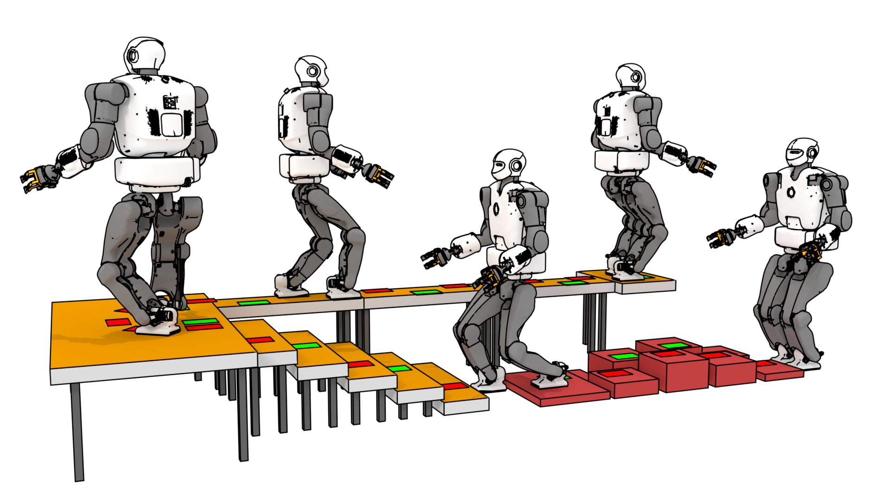

The "contact planning problem" for legged robots:
A cardinality minimisation approach
Steve Tonneau
TU Berlin
21/10/2020
Notes:
Hi ! I m Steve Tonneau from the University of Edinburgh. Today I d like to talk about locomotion for legged robots. More specifically I d like to talk about the so-called contact planning problem, which is a problem that we are very familiar with as humans being. Whenever we walk we have to constantly decide where we are going to step in order
to move closer to our objective. Consider the picture on this slide, where you can see the talos robot from pal robotics, walking on complex terrain. Starting from the bottom right position, we want to reach the end of the platform. How many steps should we make to reach our objective ? Where should each step be created ? Those questions depends on the laws of physics, the environment and the capabilities of the robot of course.
. I would like to discuss the combinatorial aspect of these questions, and propose some possible avenues of research to address it.

Slide 2

Collaborators for this work
Daeun Song and Young J. Kim
Ewha Womens University
Pierre Fernbach And Nicolas Mansard
LAAS-CNRS
Andrea Del Prete
Trento University

Slide 3
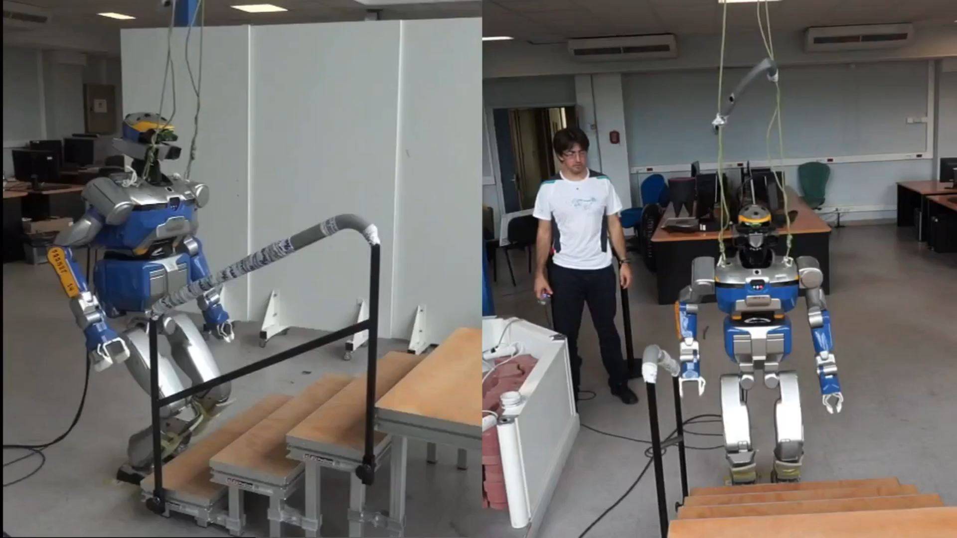
Research goal: autonomous legged locomotion
Carpentier, Tonneau, Naveau, Stasse et Mansard, ICRA 16
Notes:
Why is this an interesting problem ? This issue is related to my research objective, which I share with a large part of our community: we want to provide robots with an autonomy of motion, that is to provide them with the ability to navigate among a large variety of environments without requiring human intervention.
Unfortunately, legged motion is associated with a large variety of open problems that I would like to briefly mention here.

Slide 4
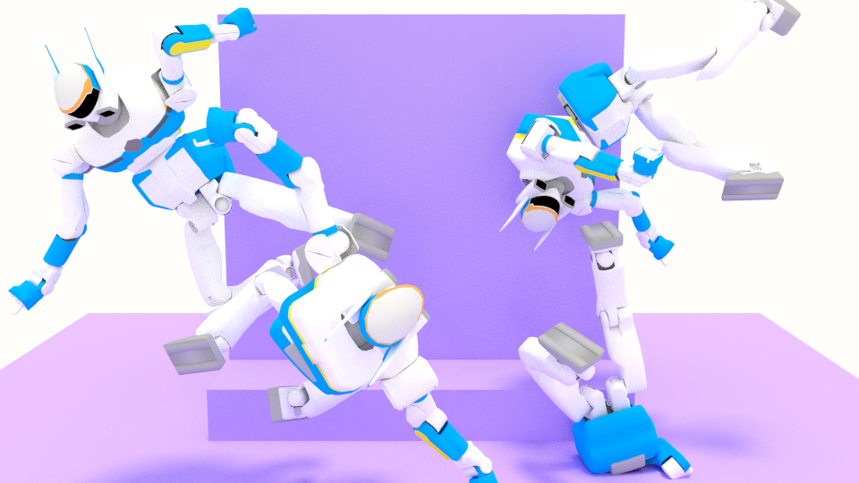
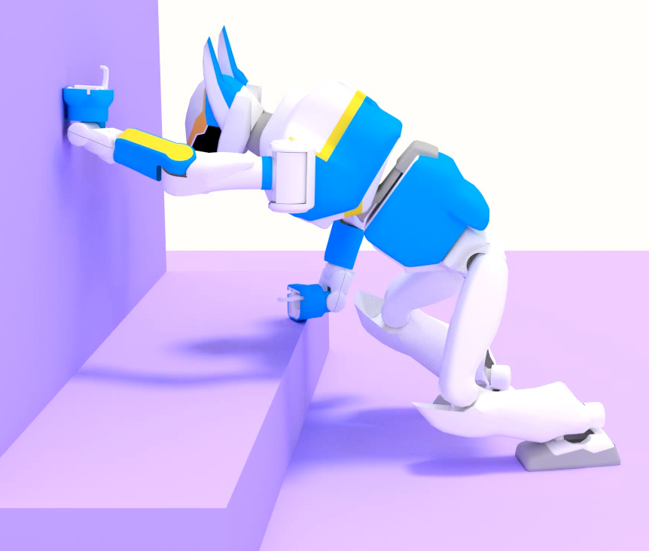
Contact postures in high-dimensional space ?

Slide 5
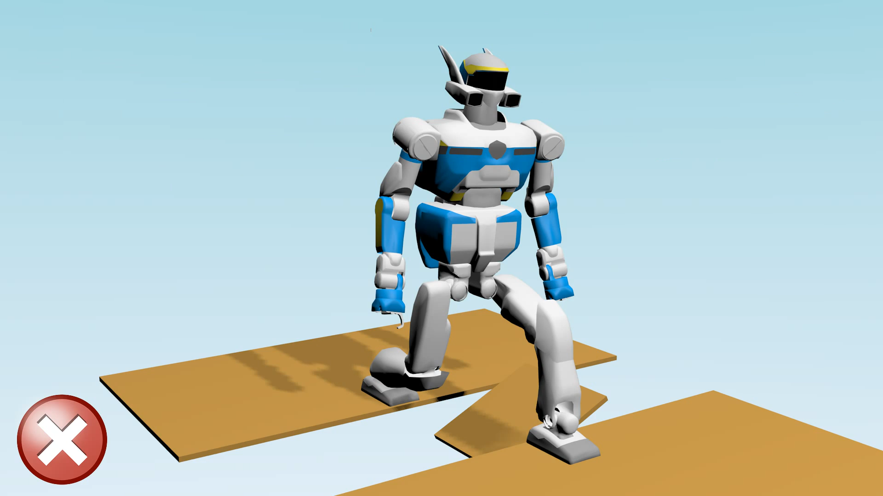
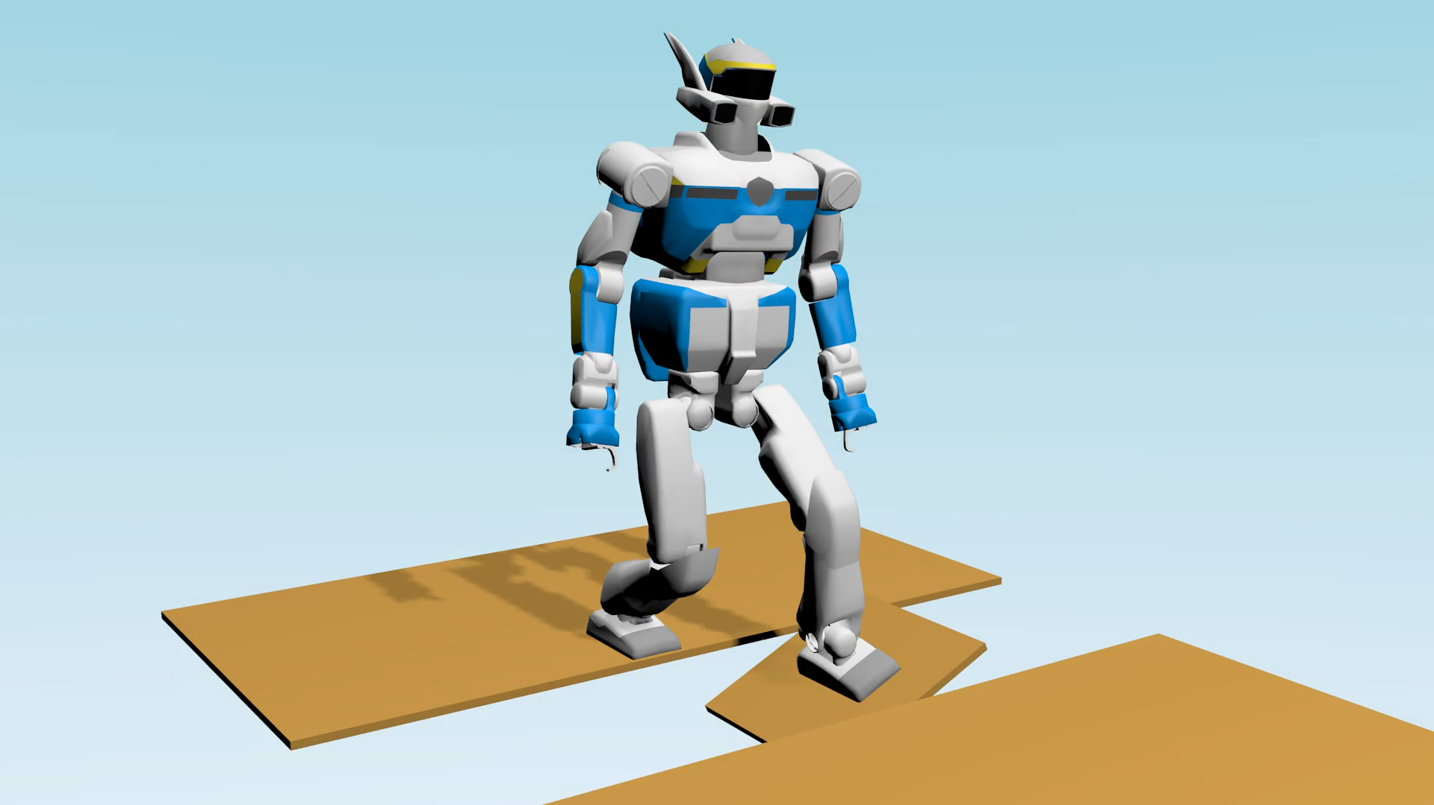
Contact-dependent, discontinuous, non-linear dynamics / geometric constraints

Slide 6
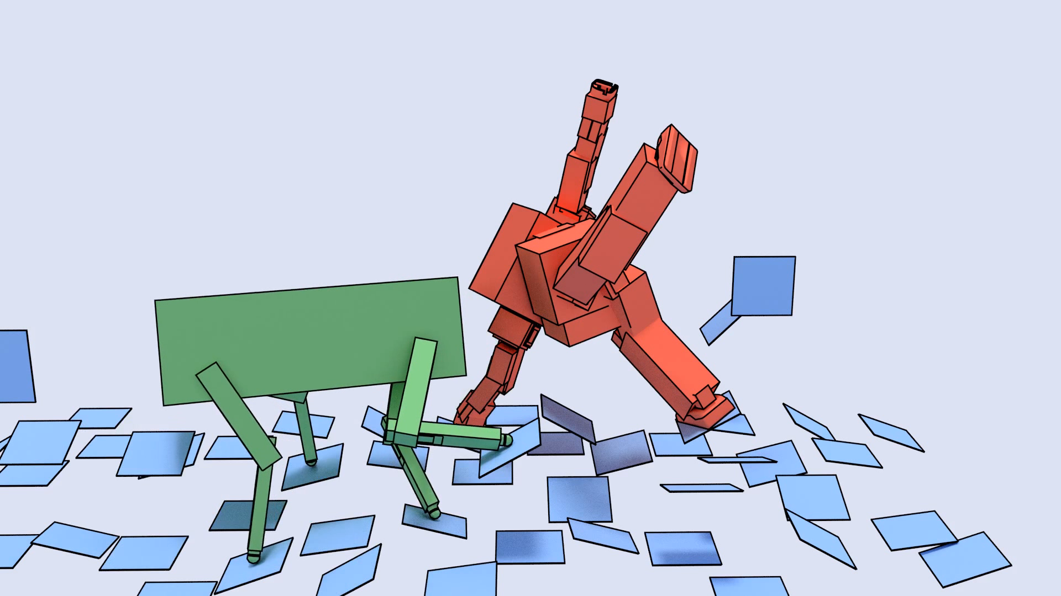
Contact interactions without collisions ?

Slide 7
Legged locomotion is too hard
We need to cheat !
This has a cost … not discussed today

Slide 8
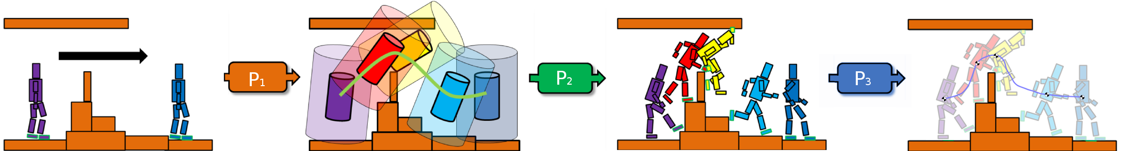
A divide and conquer approach [Tonneau et al. 15]
Global path planner
Contact
Planner
Whole body motion
generator

Slide 9
A divide and conquer approach [Tonneau et al. 15]
Global path planner
Contact
Planner
Whole body motion
generator
Solving in the feasibility domain of ?

Slide 10
A divide and conquer approach [Tonneau et al. 15]
Global path planner
Contact
Planner
Whole body motion
generator
Solving in the feasibility domain of ?

Slide 11
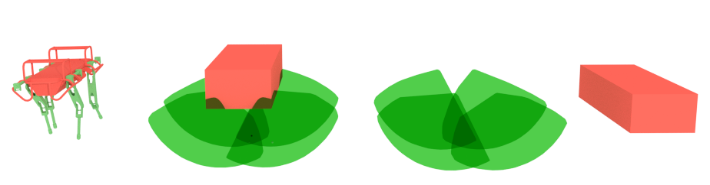
Cheating assumption: low-dimensional space
Dimensionality reduction for contacts / collision constraints [Tonneau el al. 2014]

Slide 12
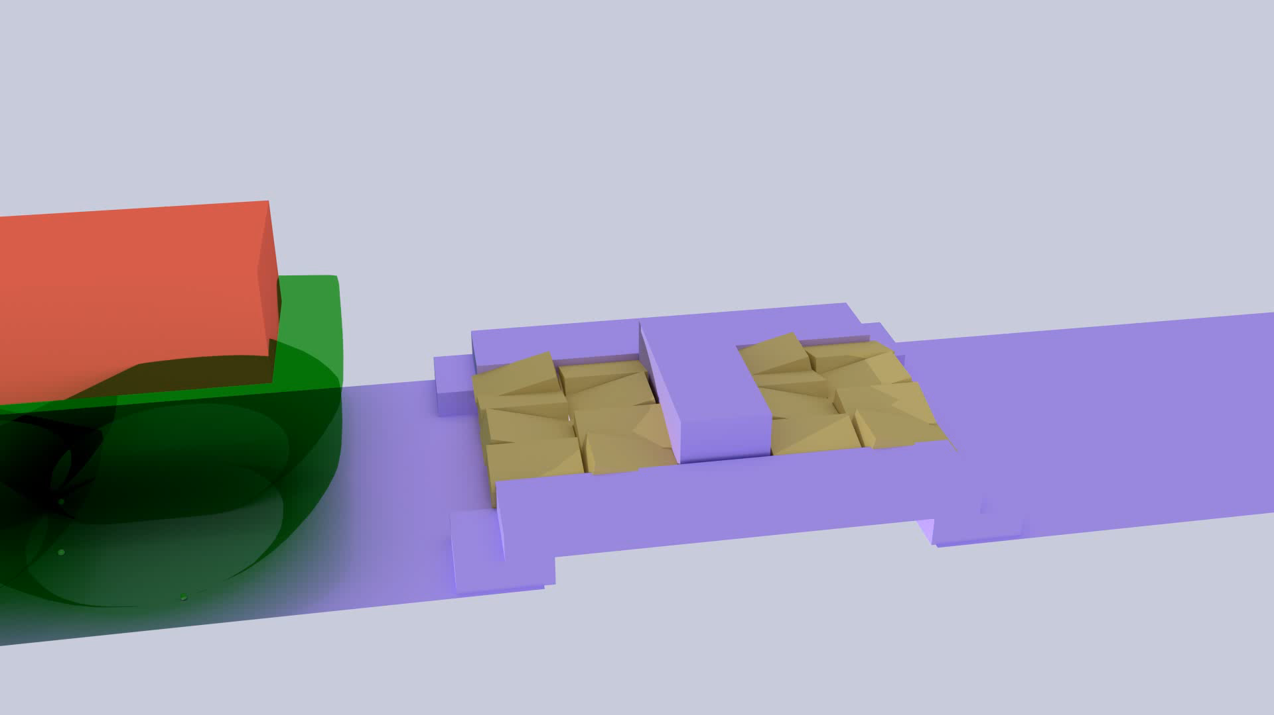
Cheating assumption: low-dimensional space
Low dimensional root path planner (RBPRM) [Tonneau et al. 15]

Slide 13
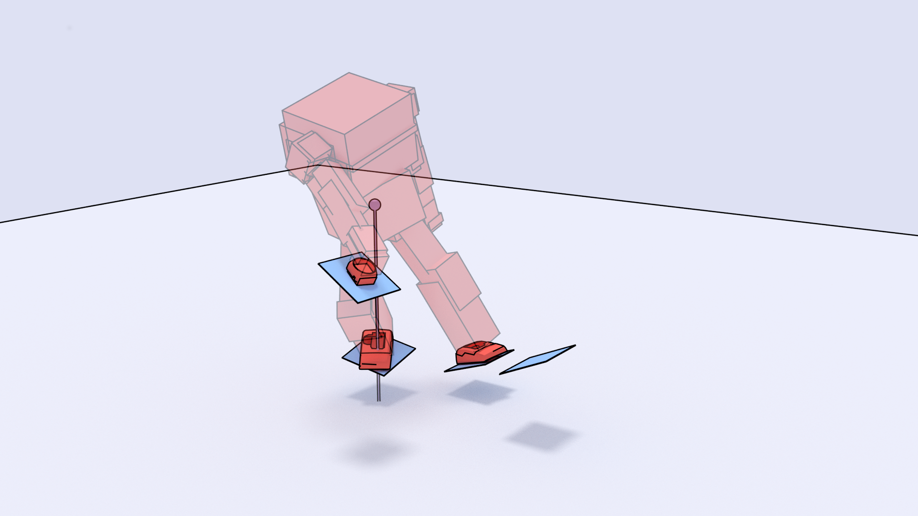
Cheating assumption: low-dimensional space
Dimensionality reduction (Centroidal model) [kajita 03, Orin 09]

Slide 14
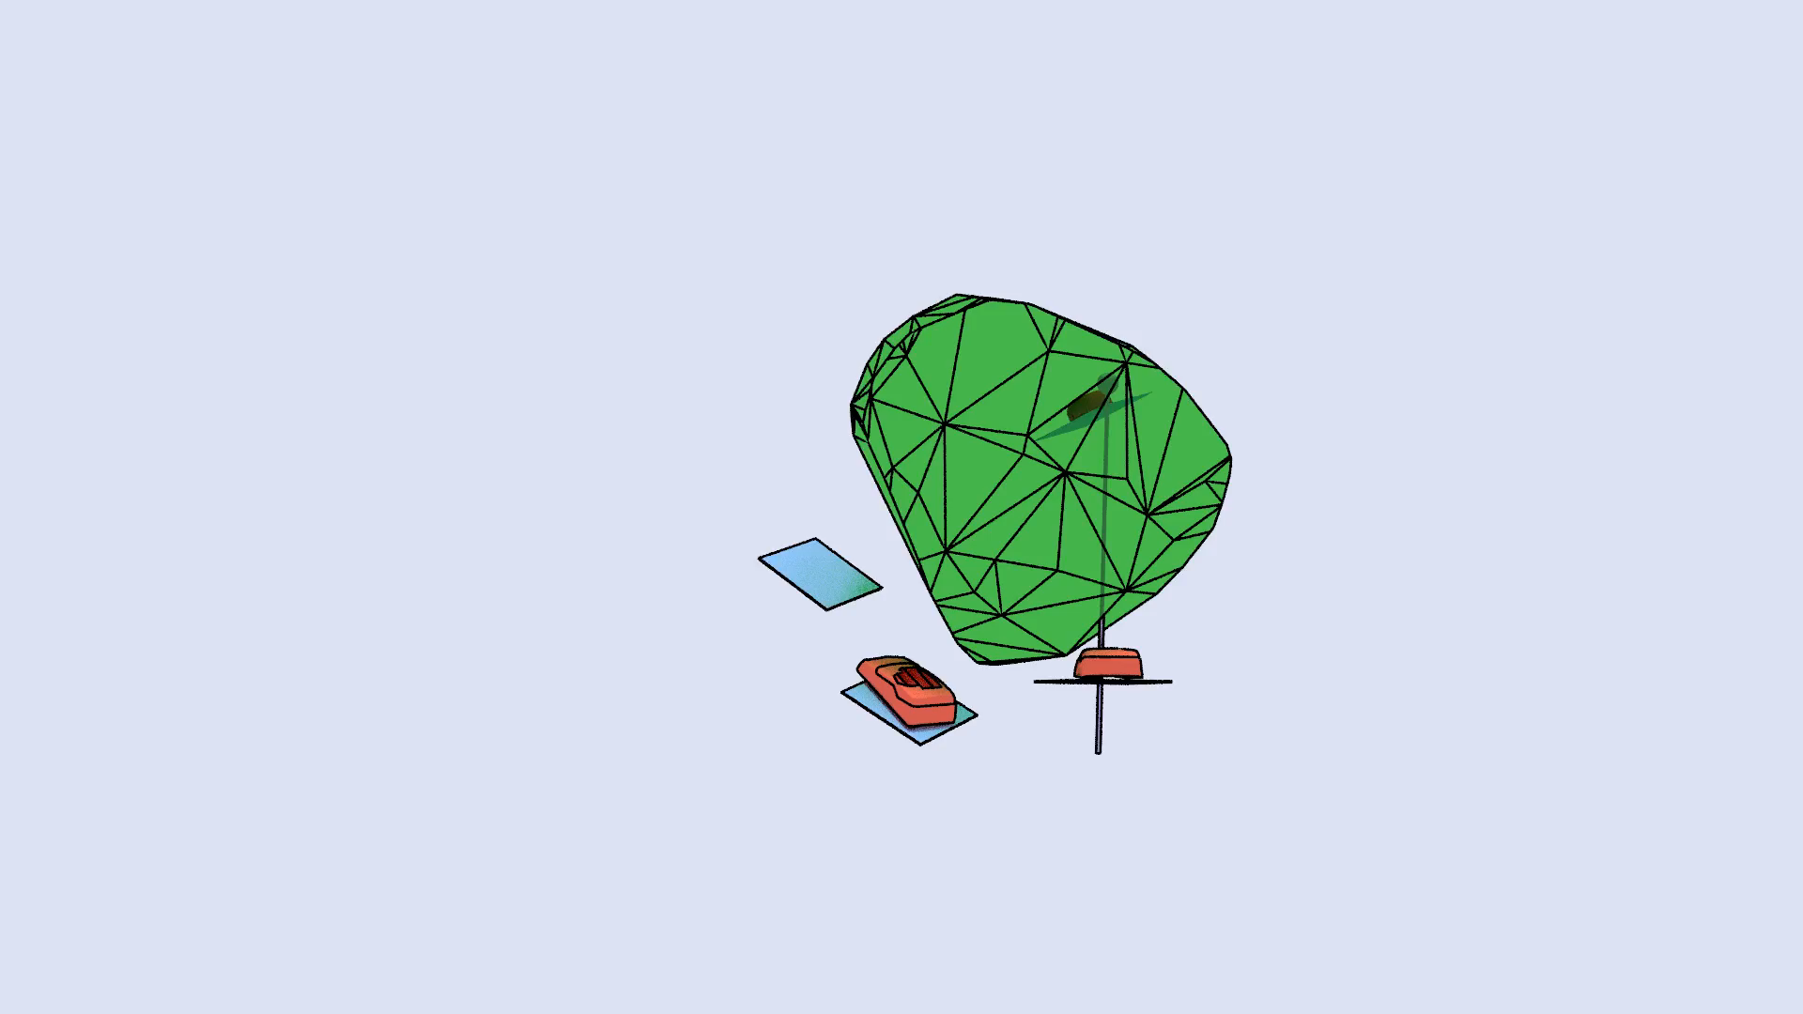
Cheating assumption: linear kinematic constraints
Linear geometric constraints [Tonneau et al. 18]

Slide 15
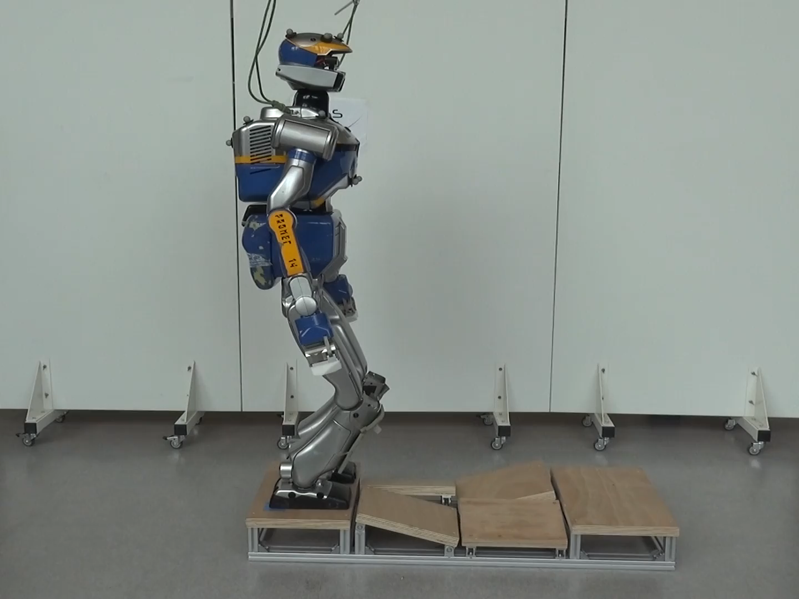
Cheat.. conservative assumption: linear dynamics
CROC [Fernbach, Tonneau el al. 2020]

Slide 16
What’s left ?
A combinatorial problem of large polynomial complexity…

Slide 17
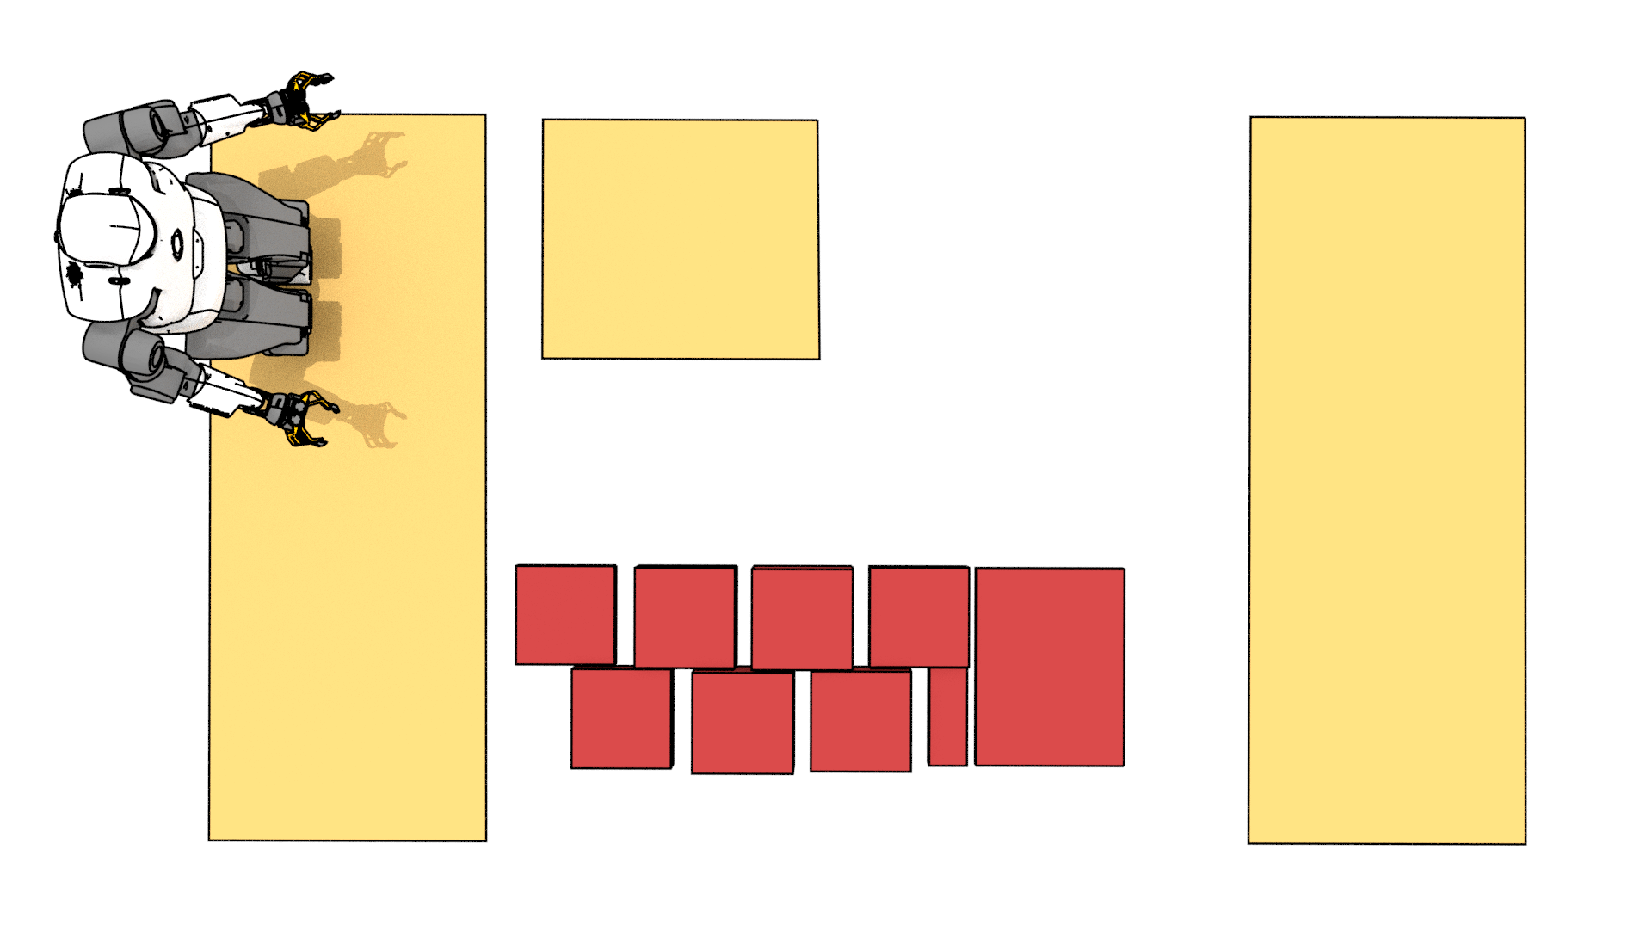
Example: how to reach the platform ?
Notes:
Let’s now consider the bird eye view of a slightly different scene and suppose we want to compute the motion that will bring talos to the other side of the platform.

Slide 18
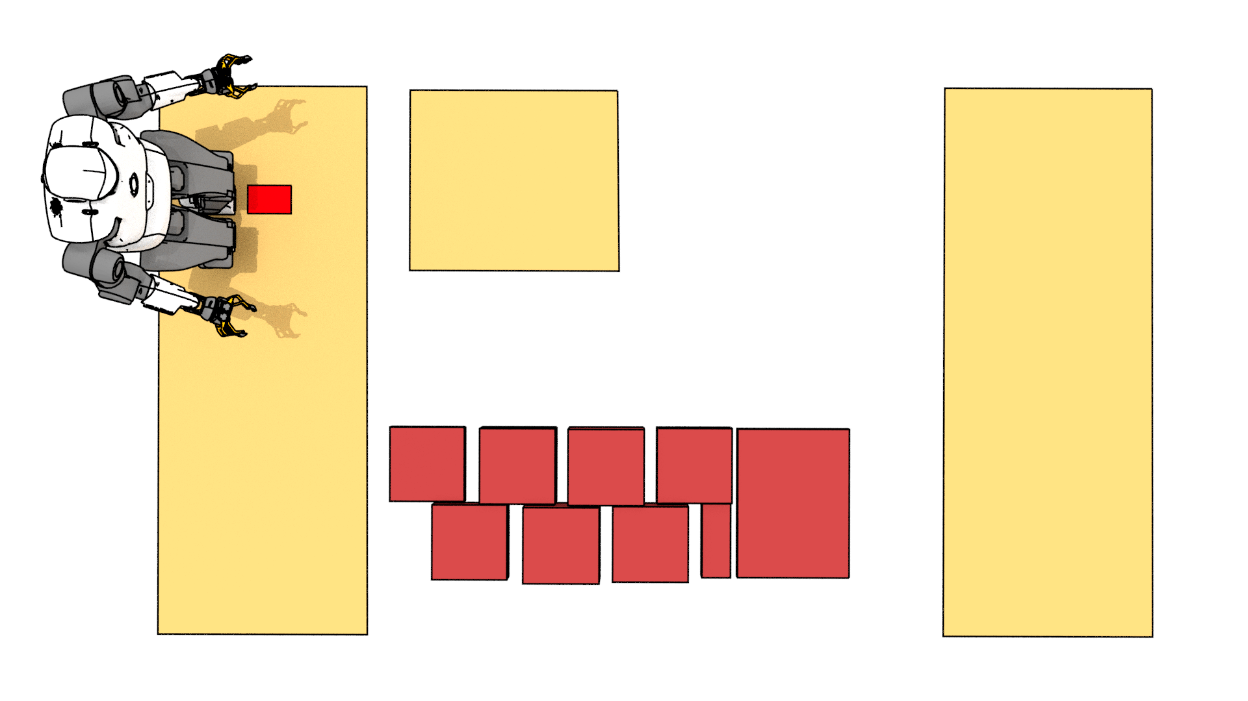
Combinatorial step planning
Notes:
Our combinatorial problem starts with the selection of the first step.
Naively, we decide to go on a straight line. We arbitrarily decide to start with the left foot and place it at the red position on the first platform.

Slide 19
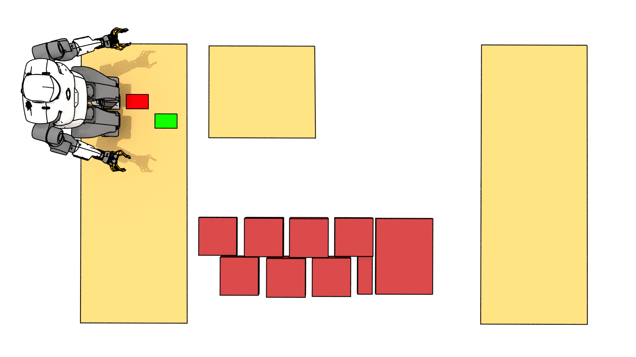
Combinatorial step planning
Notes:
Similarly, assuming a cyclic motion we now place the right foot at the green position. Now ideally we would like to make our next step on the second platform.
However, we need to account for the feasibility of our contact plan.

Slide 20

Combinatorial step planning
Feasibility :
Geometric constraints
Notes:
This crescent approximates the kinematic constraints of talos. With a right foot on the green location, the center of the left foot must belong to the crescent
To satisfy the geometric feasibility.

Slide 21
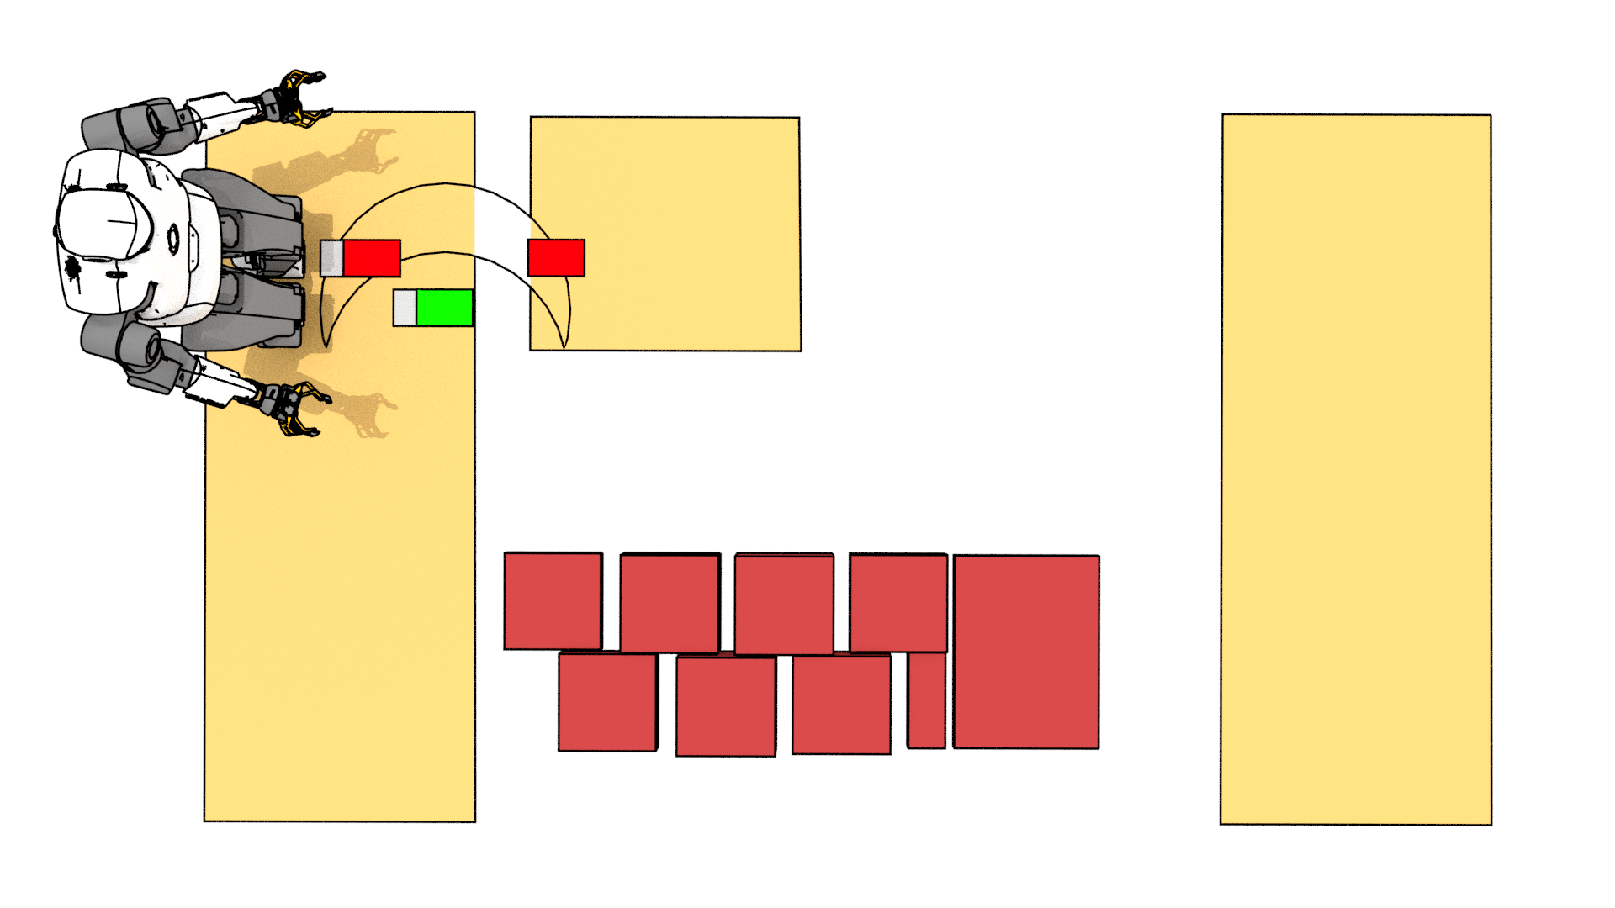
Combinatorial step planning
Feasibility :
Geometric constraints
Notes:
It appears safer to backtrack our contact plan and place the first step a little bit forward. This allows for the third step to lie completely on the second platform.

Slide 22
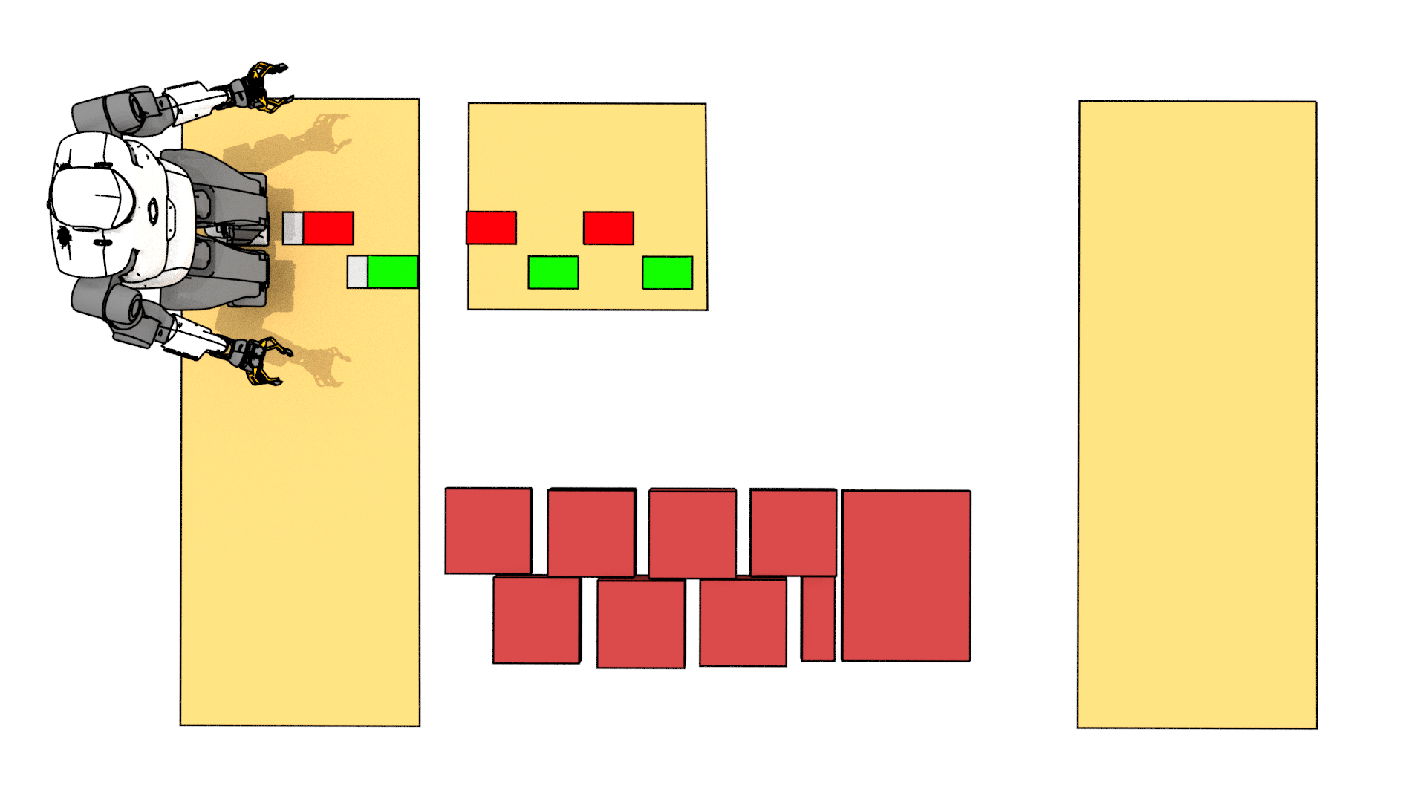
Combinatorial step planning
Global path search
Feasibility :
Geometric constraints
Notes:
Unrolling our naïve policy, we end up in a local minima. You probably saw it coming a while ago, but most algorithms will exhibit this myopic behaviour as they only
plan a few steps ahead. We thus need to plan the path to our goal GLOBALLY, with as many steps in advance as possible. This is of course problematic when dealing
with combinatorial problems.

Slide 23
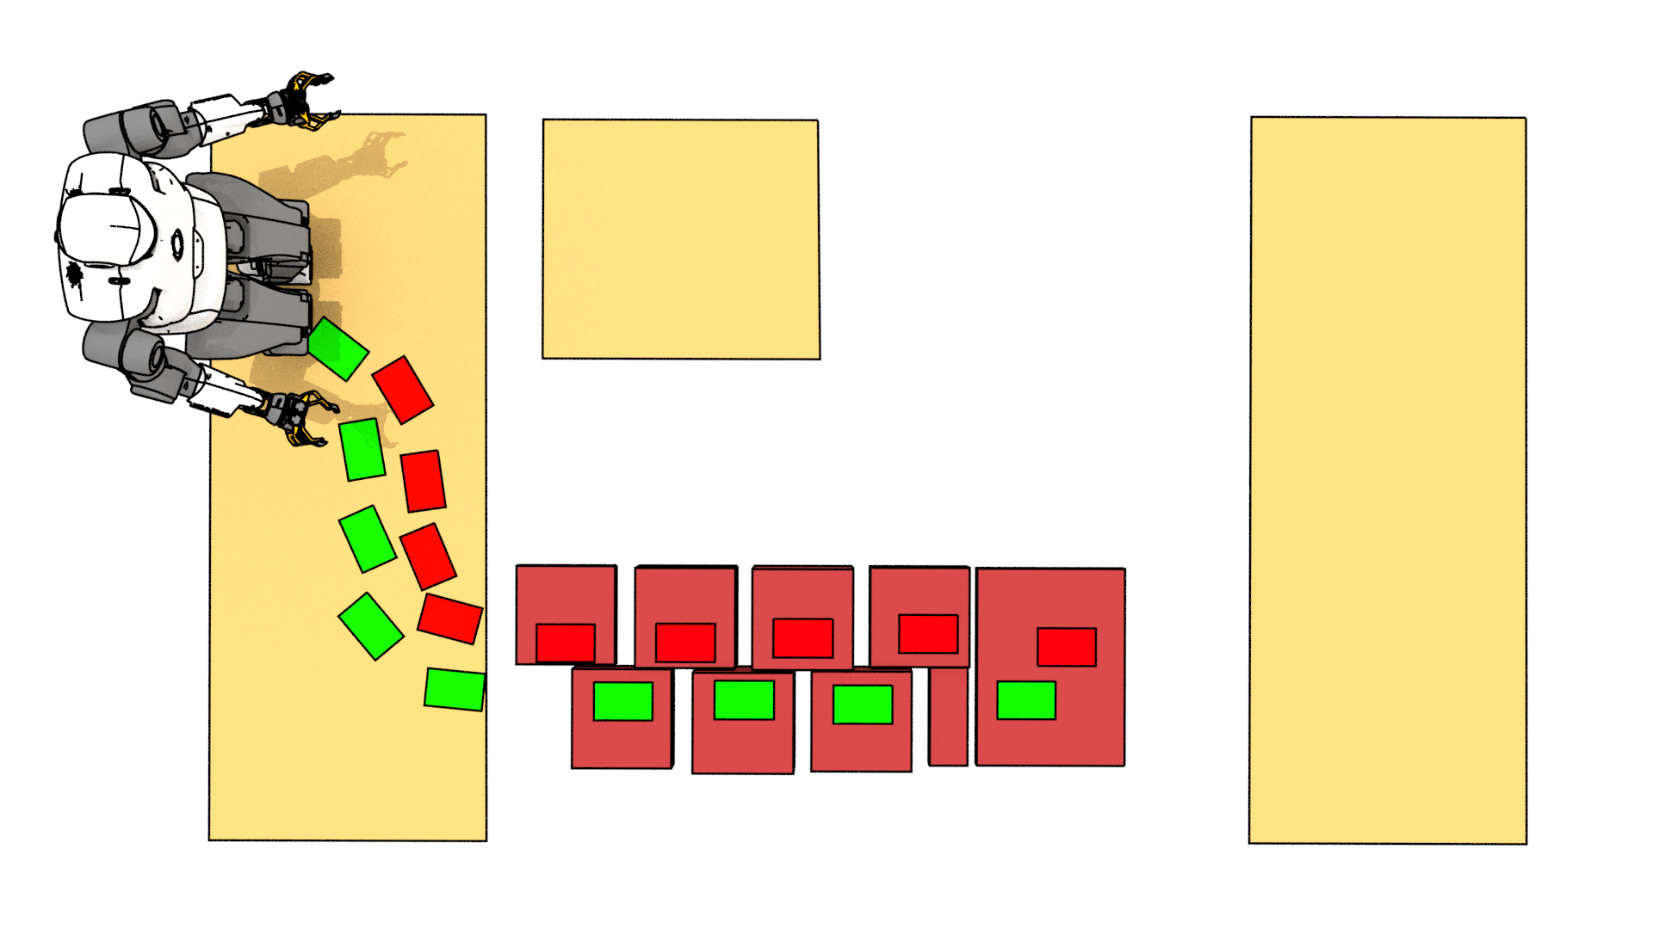
Combinatorial step planning
Global path search
Feasibility :
Geometric constraints
Notes:
Backtracking again, after a few trials and error we may end up in this situation. We are at the border of the red stepping stones, however we are not able to cross the final step.
Again, our plan is not feasible. This time it is not because of geometric constraints but because of the dynamics.

Slide 24
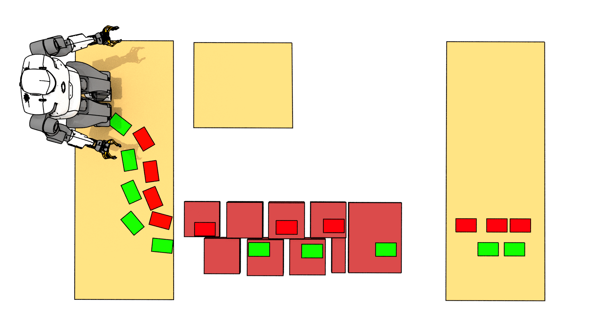
Combinatorial step planning
Global path search
Feasibility :
Geometric constraints
Dynamic constraints
Notes:
To cross the gap we need to reach the last stepping stone with enough velocity to jump. Dynamic feasibility must thus be considered as well. The issue is obvious in this dynamic situation, however even when walking
We must of course continuously ensure that the robot can maintain equilibrium while following the footsteps.

Slide 25
Which contact surface ?
?
?
?
?
?
?
?
?
?
?
?
?
Notes:
In summary, at each new step we must choose a contact surface such that the motion is feasible and make sure that it allows us to make progress towards our goal.
Let’s formalize the contact selection problem.

Slide 26
Which contact surface ?
Convex contact surfaces:
Footsteps positions:
?
?
?
?
?
?
?
?
?
?
?
?
Notes:
We assume a quasi flat environment, with n candidate contact surfaces. We assume the surfaces are convex. Thus a surface Sj can be represented by a set of linear inequalities.
At each new phase i we associate one footstep position p_i.

Slide 27
Which contact surface ?
Convex contact surfaces:
Footsteps positions:
Combinatorial:
?
?
?
?
?
?
?
?
?
?
?
?
Notes:
A contact point p_i is constrained to belong to any of the n surfaces.
So for each step, there are n possibilities. For planning m steps, there are n to the power of m possible combinations.
The number of possibilities thus explodes with the number of steps that we want to plan.

Slide 28
Which contact surface ?
Convex contact surfaces:
Footsteps positions:
Combinatorial:
?
?
?
?
?
?
?
?
?
?
?
?
Notes:
A contact point p_i is constrained to belong to any of the n surfaces.
So for each step, there are n possibilities. For planning m steps, there are n to the power of m possible combinations.
The number of possibilities thus explodes with the number of steps that we want to plan.

Slide 29
Contact planning as a feasibility problem
// Feasibility
// Initial and goal conditions
Notes:
Our problem can be written in the following general form:
Find m contact positions (that s the variable X), such that the kinematic and dynamic feasibility of the plan is guaranteed, and such that
The initial and final conditions of the problem are met. (In our previous example a goal condition is that the robot lies on the platform on the far right)
The combinatorial constraint is that at each phase I, the contact position pi must lie on either of the contact surface.

Slide 30
Contact planning as a feasibility problem
// Feasibility
// Initial and goal conditions
How to tackle the combinatorics ?
Notes:
This is our starting point. Let’s try to see how we can try to handle the combinatorial efficiently.
Handling the OR constraint usually involves solving a mixed integer linear program, which can lead to a combinatorial explosion.
Our objective is thus to get rid of the OR constraint and relax this problem as a convex linear programm. For this, we will assume that the feasibility, initial and goal
Constraints are convex, following the assumptions that we mentioned before.

Slide 31
An equivalent cardinality minimisation problem
Notes:
If a point pi lies on SJ, then this inequality is necessarily satisfied.
In our example there are no overlap between the contact surfaces so only one such inequality can be satisfied at each phase.
But what if we wanted to satisfy them all simultaneously ?

Slide 32
An equivalent cardinality minimisation problem
Slack variables
c_{0,1}>0
c_{0,11}>0
c_{0,0}=0
Notes:
We can introduce positive slack variables c i j, one for each contact surfaces at each phase. For an arbitrarily large value of c i j the constraints will always be satisfied.
On the other end if c i j is equal to 0 then necessarily pi belongs to the surface sj

Slide 33
An equivalent cardinality minimisation problem
Slack variables
c_{0,1}>0
c_{0,11}>0
c_{0,0}=0
Notes:
We can use the ci vector, which contains all the c i j, to draw a necessary condition for the point pi to lie on a surface. If the number of non zeros in ci is less than the total number of surfaces, pi is necessarily on a contact surface. This number is called the cardinality
of the vector. As our surfaces are not intersecting, we know that the minimum value is n-1.

Slide 34
An equivalent cardinality minimisation problem
c_{0,1}>0
c_{0,11}>0
c_{0,0}=0
Notes:
This shows that finding a point pi on a surface is strictly equivalent to an optimization problem where we try to minimize the cardinality of the slack vector ci.
At the minimum one of the cij is equal to 0, thus pi belongs to a surface.

Slide 35
An equivalent cardinality minimisation problem
Notes:
We can thus reformulate our original problem and remove completely the or constraint.
We traded the feasibility problem for a strictly equivalent minimization problem.
Still, minimizing the cardinality of a vector is in fact also a mixed integer optimization.
So it seems that we have not progressed that much!

Slide 36
Convex relaxation with sparsity inducing norm
Notes:
Fortunately, it is well known that the cardinality minimization problem can be well approximated by a l1 norm minimization problem.
The l1 norm minimization induces sparsity which means that we can hope that some entries of the ci vectors will be 0 at the end of the optimisation.
Why is this the case ? I d like to give an informal justification

Slide 37
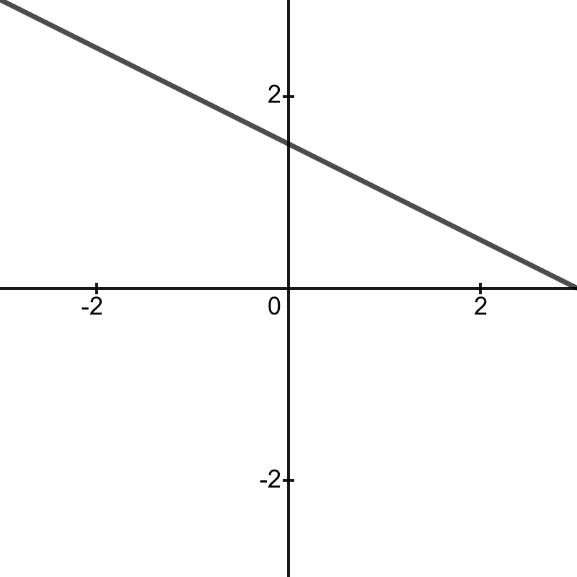
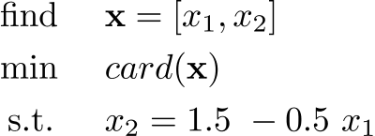
L1 Norm induces sparsity
[0,1.5]
[3,0]

Slide 38
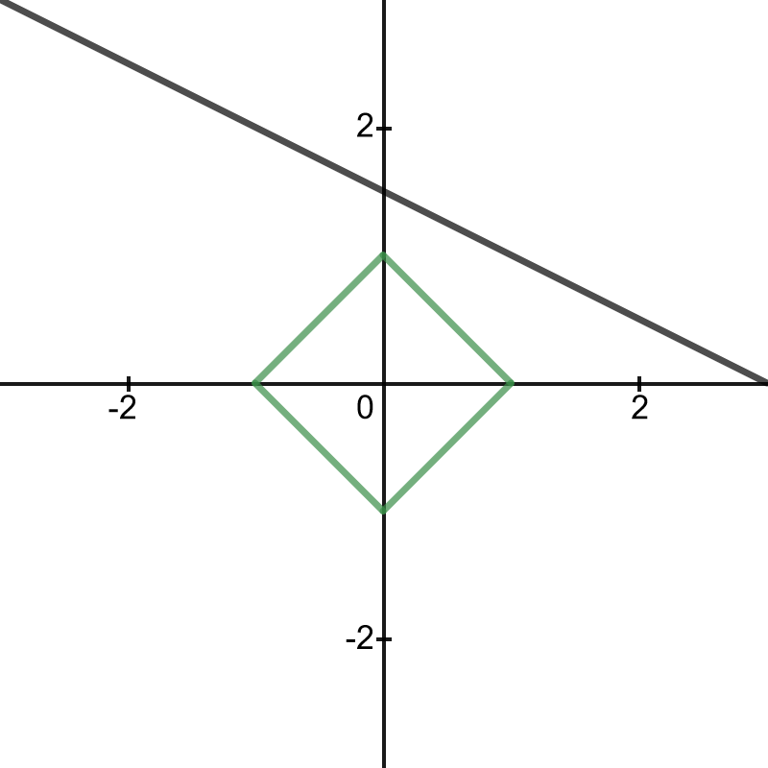


L1 Norm induces sparsity

Slide 39
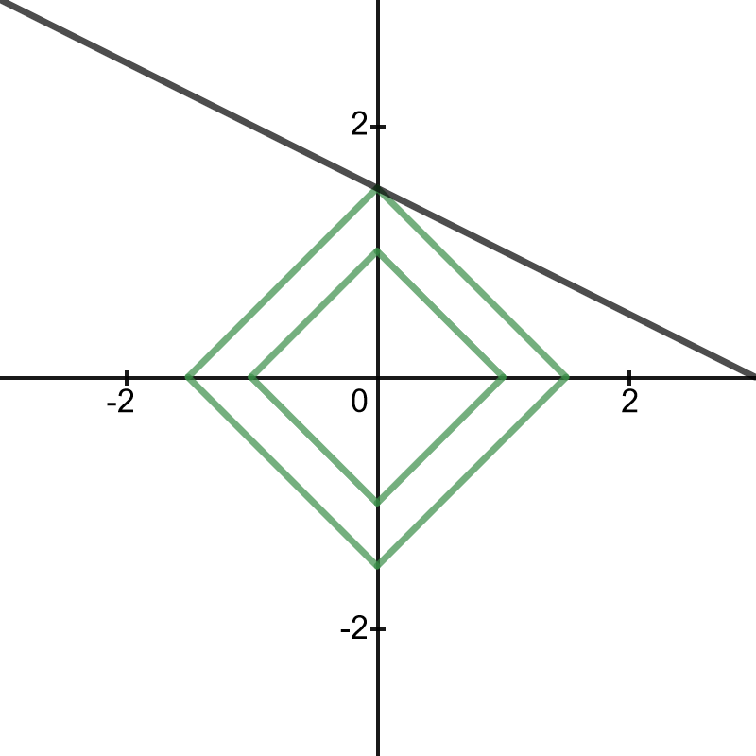

L1 Norm induces sparsity
[0,1.5]

Slide 40
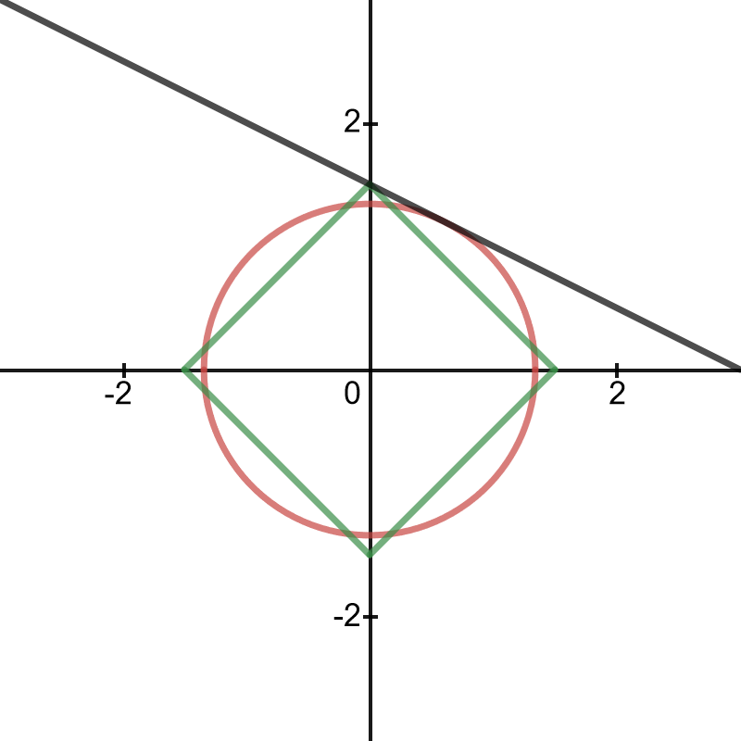

Euclidian norm does not lead to sparsity

Slide 41
Convex relaxation with sparsity inducing norm

Slide 42
Some results

Slide 43
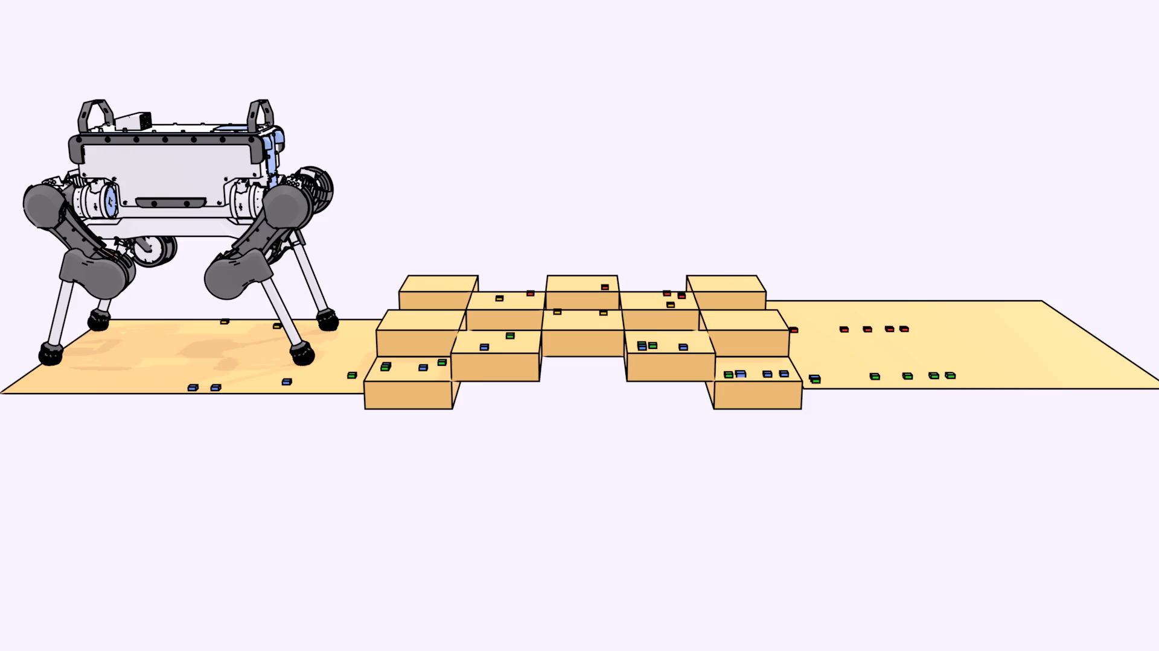
Ongoing work: extension to quadrupeds

Slide 44
L1 relaxation is faster, but less reliable
L1 up to 10x faster than Mixed-Integer (MI) solvers…
What if relaxed problem does not converge to sparse solution ?
Can we guarantee convergence ?
A more general question: Is this really a combinatorial problem?
Notes:
The main advantage of the approximation is computational efficiency. Our method 100 times faster than the mixed integer formulation in the most favorable cases when considering
an additional objective function
However the drawback is that the relaxation can converge to unfeasible solutions, and handling those cases can reduce the computational advantage.
Further research is needed to deeply understand the cases where sl1m is advantageous over MIP.

Slide 45
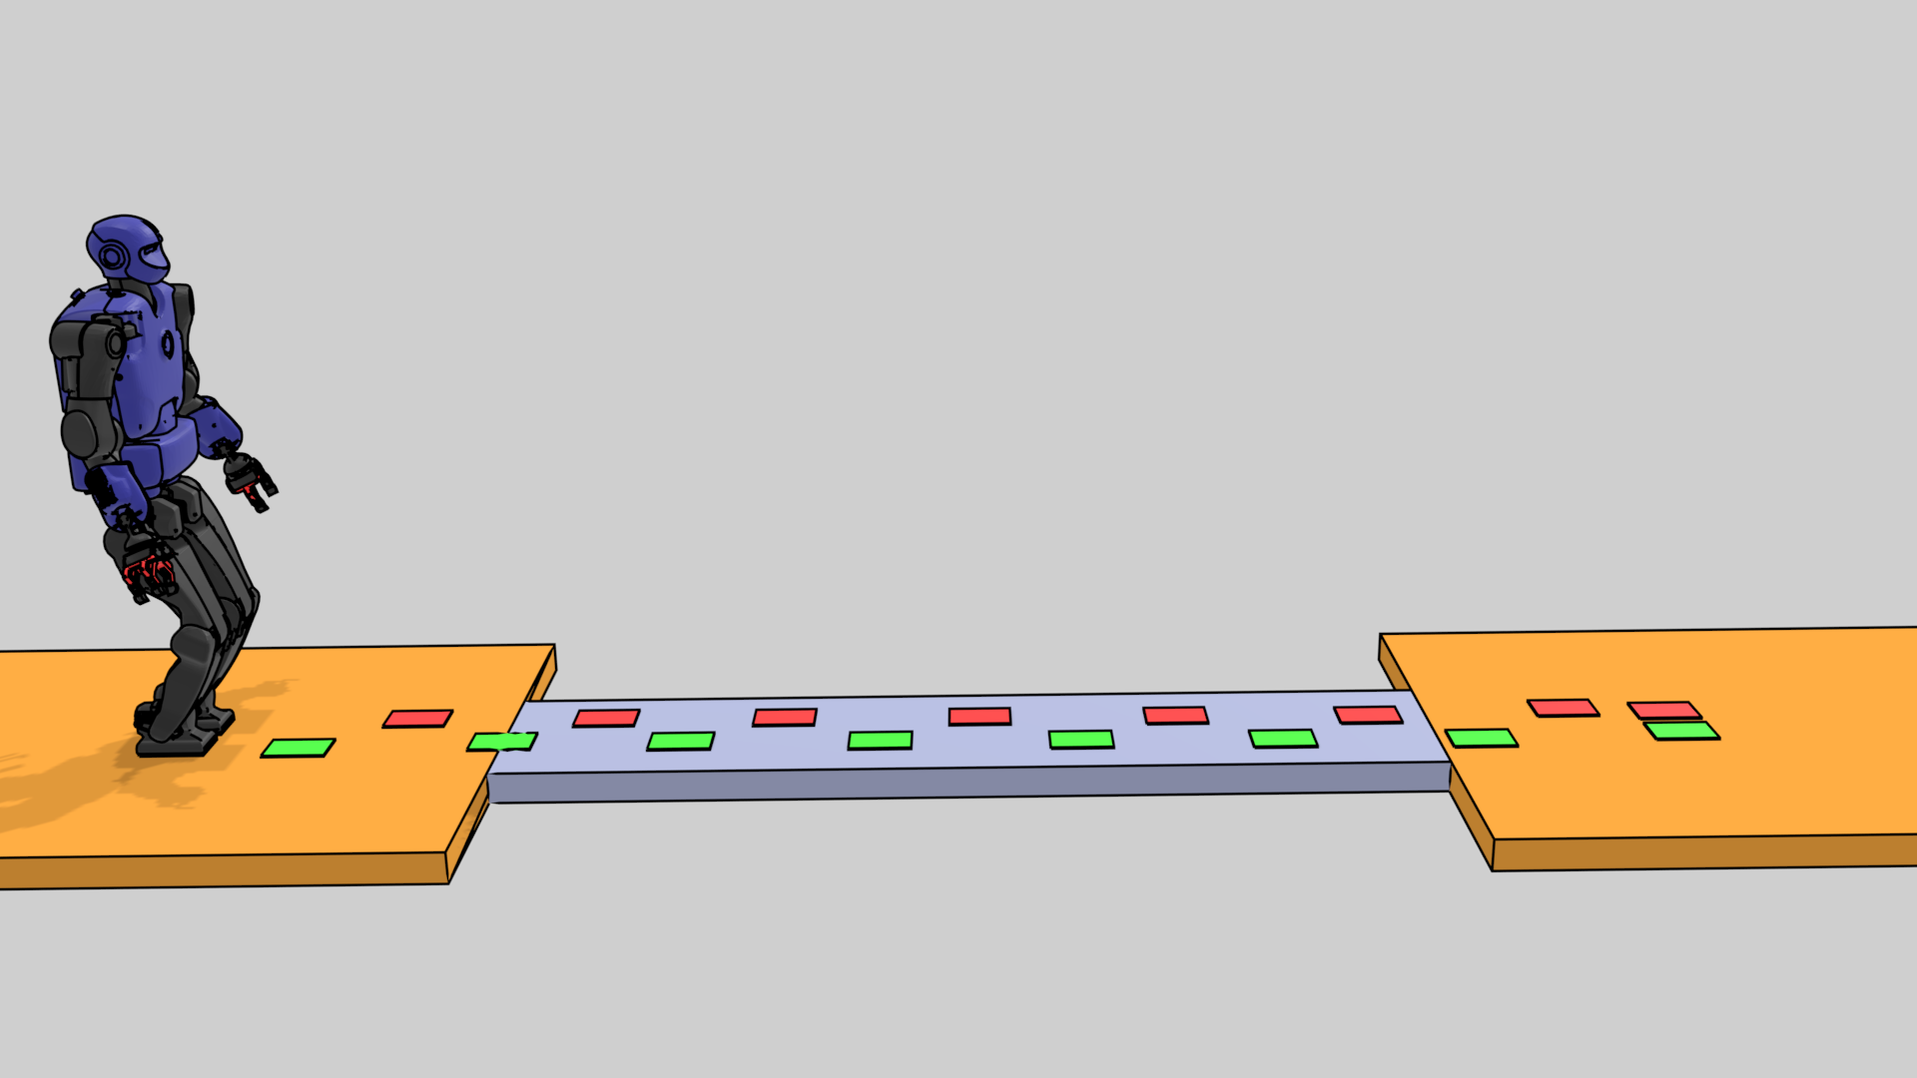
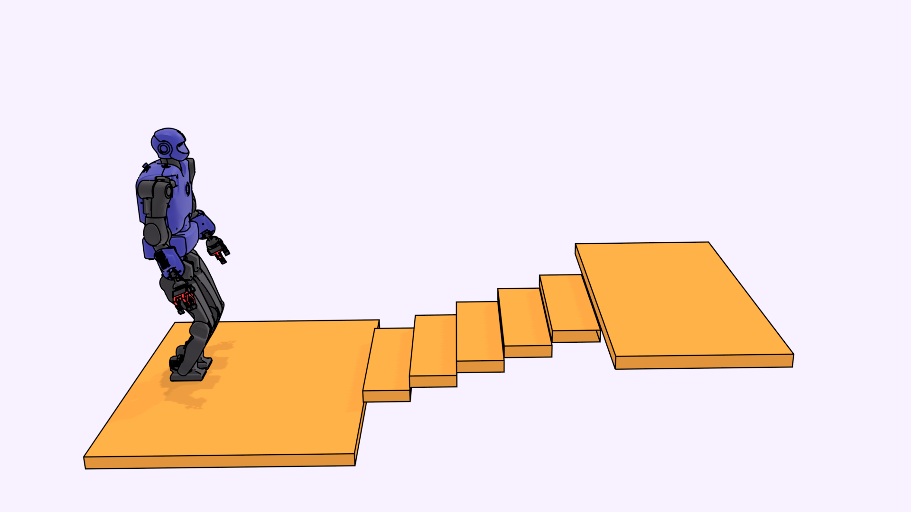
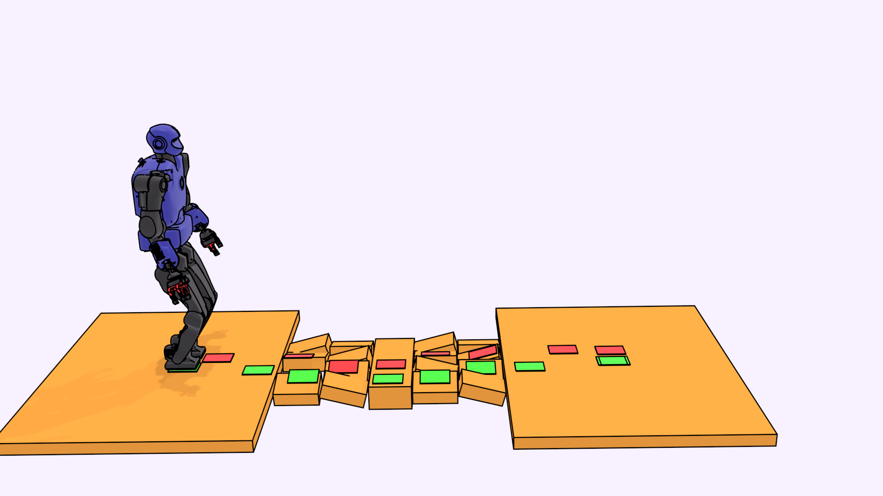
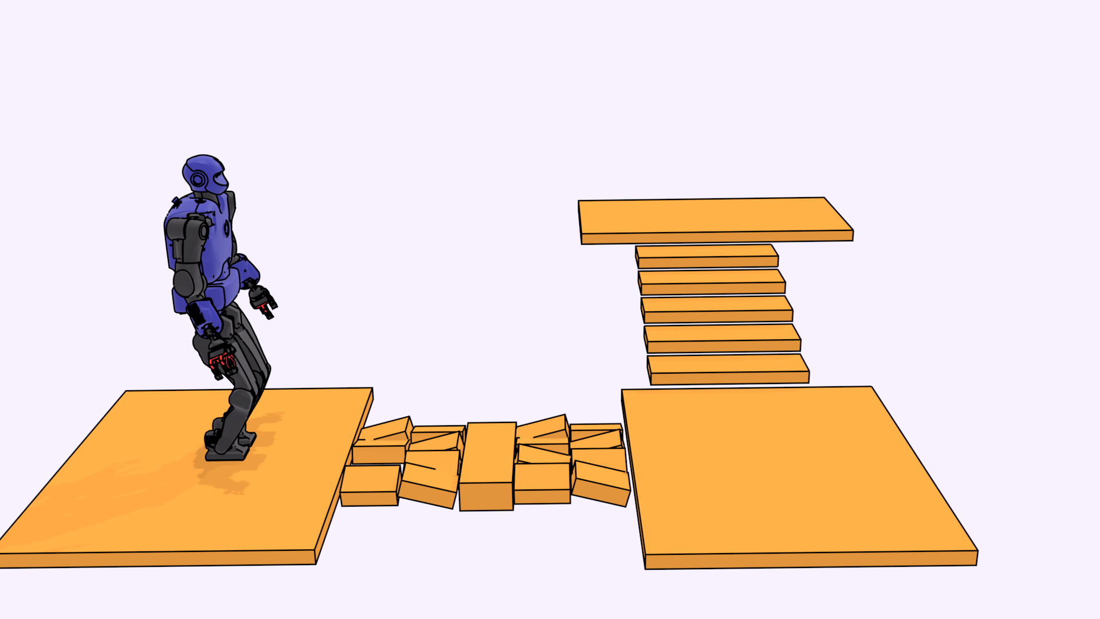
Let’s look at the number of nodes explored by MI:
MIP (+cost) | 0 (1) | 0 (1) | 383 (2742) | 2724 (20452)
L1 success | V | V | X | X

Slide 46
Let’s look at the number of nodes explored by MI:
« Presolve» option:
does not change optimum
discard unfeasible solutions
additional constraints => slower resolution time
MIP (+cost) | 0 (1) | 0 (1) | 383 (2742) | 2724 (20452)
L1 success | V | V | X | X

Slide 47
With presolve, at most 1 node exploration for feasibility problem
MIP - No presolve | 0 (1) | 0 (1) | 383 (2742) | 2724 (20452)
MIP -Presolve | 0 (1) | 0 (1) | 1 (1) | 1 (2960)

Slide 48
With presolve, at most 1 node exploration for feasibility problem
MIP - No presolve | 0 (1) | 0 (1) | 383 (2742) | 2724 (20452)
MIP -Presolve | 0 (1) | 0 (1) | 1 (1) | 1 (2960)
Can we use a « custom» presolve for L1 norm minimisation ?

Slide 49
COMPLEXITY CAN BE REDUCED WITH A GUIDE

Slide 50
COMPLEXITY CAN BE REDUCED WITH A GUIDE
Contact surfaces
Steps:
?
?
?
?
?
?
?
?
?
?
?
?

Slide 51
COMPLEXITY CAN BE REDUCED WITH A GUIDE
Contact surfaces
Steps:
Combinatorial:
?
?
?
?
?
?
?
?
?
?
?
?

Slide 52
Guide-path improves slim convergence, but also MIP performances
L1 success | V | V | X | X
Guide + L1 | V | V | V | V

Slide 53
Ok but why bother ? Computational time (ms)
Tradeoff guide cost (about 100 ms) / Solver time
Guide + L1 | 35 | 20 | 73 | 219
Guide + MIP | 77 | 34 | 230 | 508
MIP | 166 | 59 | 389 | 74710

Slide 54
Early conclusions for footstep planning
Refining problem definition leads to vanishing combinatorics
    Using domain-specific knowledge seems promising
    Other issues to consider (what is the right path discretisation ?)
    L1-norm relaxation converges to feasible solution faster
    What about more challenging problems (gait selection) ?
    Optimality ? I think we do not care!

Slide 55
Overall conclusions for Contact planning
Should we embrace combinatorics or try to ignore it ?
  What can we expect for more challenging tasks ?
  ie. Can we « presolve » harder problems ?
  Non-linear problems, unknown gait patterns
  I believe those questions are challenging, important and fun

Slide 56
That’s all for now
https://stevetonneau.fr for papers, videos, source code
Notes:
That s about all I have to say in 10 minutes. Please consult my website stevetonneau.fr for the paper, video and source code. I will be very happy to take questions during ICRA or at any other time by email.

