Slide 1
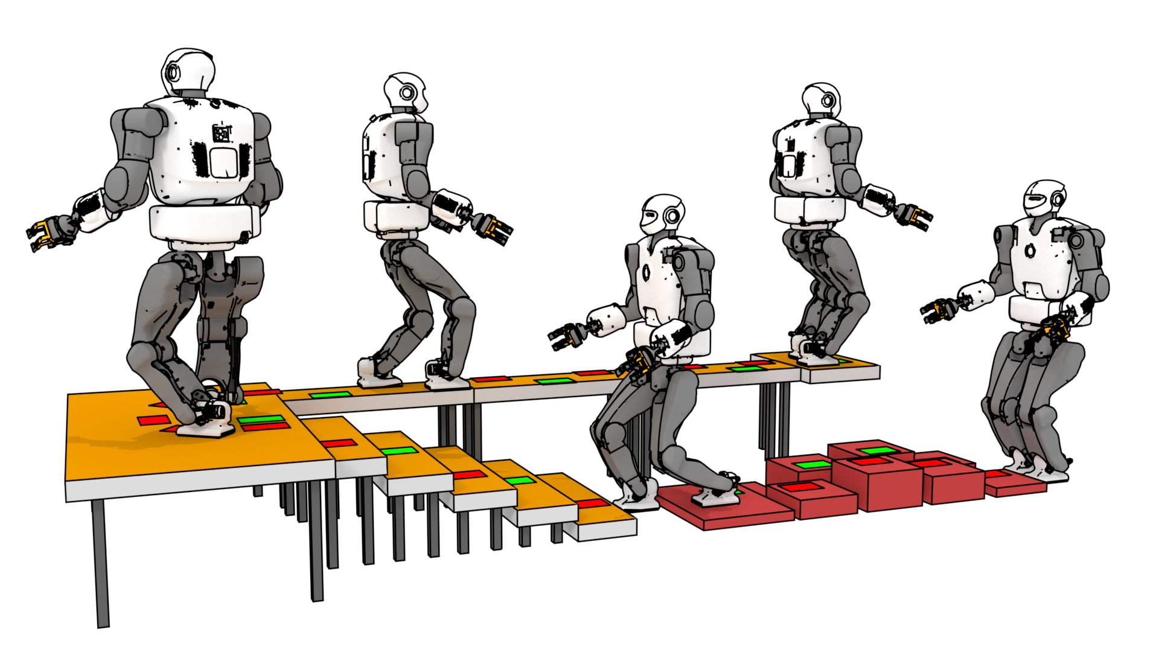



SL1M: Sparse L1-norm Minimization for
contact planning on uneven terrain
Steve Tonneau - Daeun Song
Pierre Fernbach - Nicolas Mansard
Michel Taïx - Andrea Del Prete
Notes:
Hi ! I m Steve Tonneau from the University of Edinburgh. I m here to present SLIM, a method for efficiently planning legged locomotion using convex optimization. This work is sponsored by the H2020 Memmo Project and has been achieved in collaboration with folks from LAAS CNRS, The university of Trento and Ewha womans University.

Slide 2
LEGGED LOCOMOTION IS DEFINED
PRIMARILY BY CONTACTS
Notes:
To motivate our problem, let’s consider one of our example result. Here you can see the talos robot from pal robotics, walking on complex terrain. Obviously, the feasibility and the quality of the motion is primarily defined by contacts timings and locations. In particular in this work we are interested in finding where to create them: at each new step we have a discrete choice of contact platforms and an infinity of possibilities on each of those platforms. We want to address
this combinatorial problem as efficiently as possible.

Slide 3
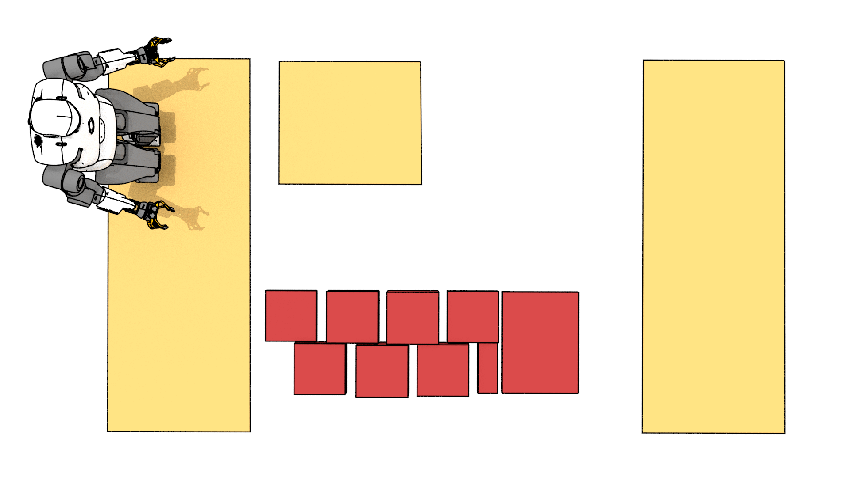
Notes:
Let’s now consider the bird eye view of a slightly different scene.

Slide 4

HOW TO REACH THE PLATFORM ?
Notes:
Let’s now consider the bird eye view of a slightly different scene and suppose we want to compute the motion that will bring talos to the other side of the platform.

Slide 5
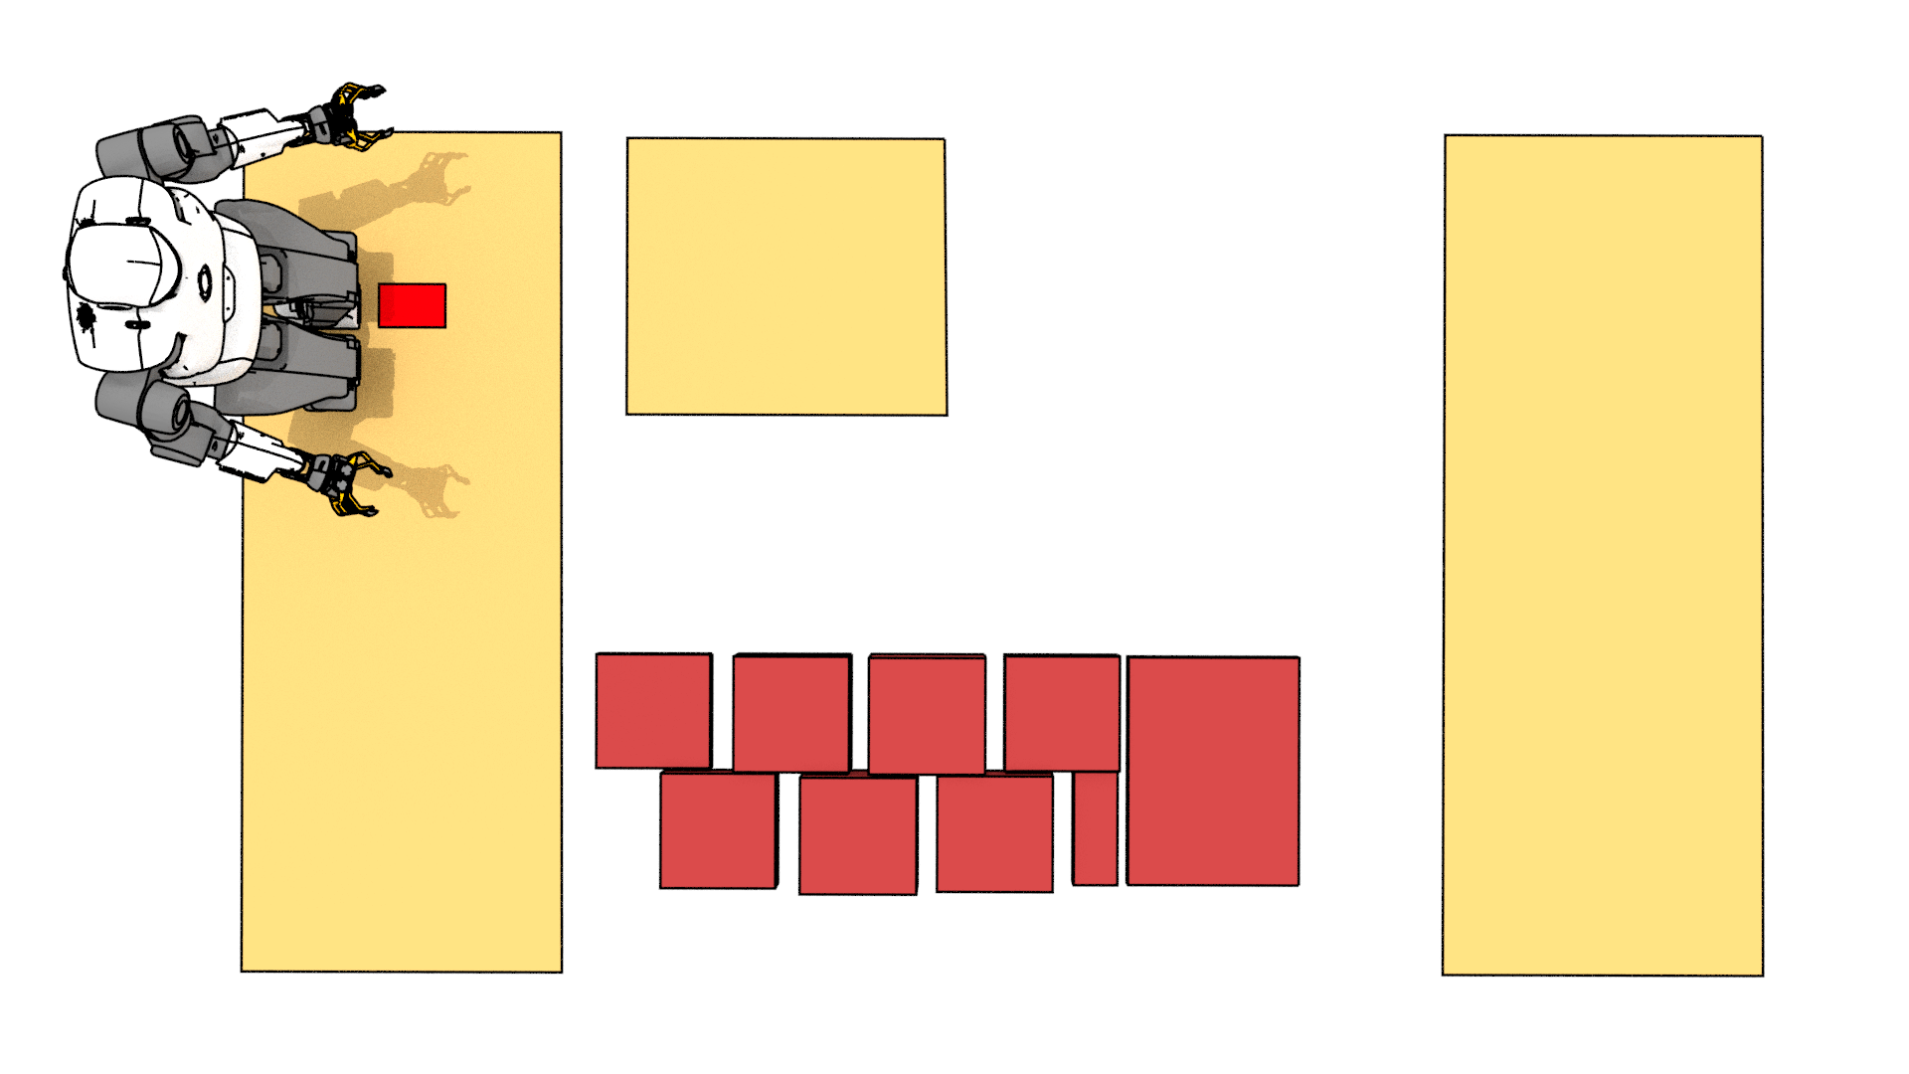
COMBINATORIAL STEP PLANNING
Notes:
Our combinatorial problem starts with the selection of the first step.
Naively, we decide to go on a straight line. We arbitrarily decide to start with the left foot and place it at the red position on the first platform.

Slide 6
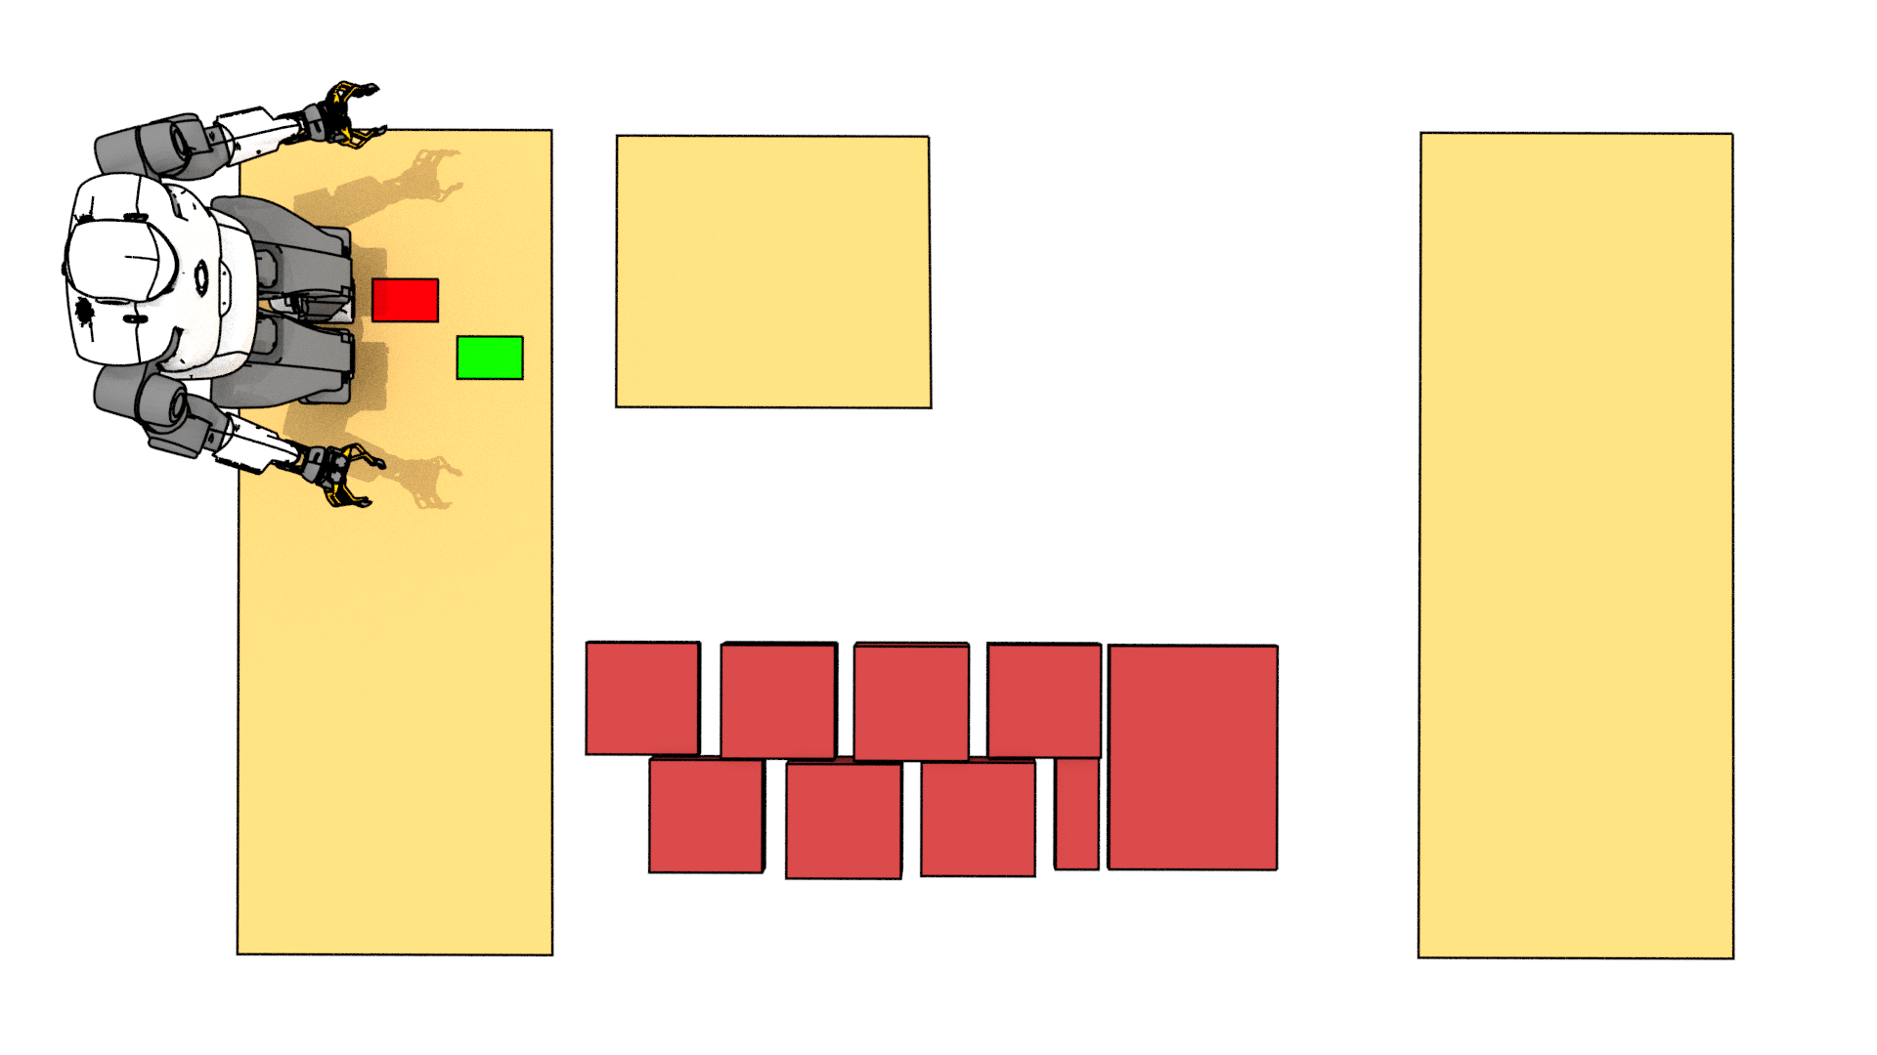
COMBINATORIAL STEP PLANNING
Notes:
Similarly, assuming a cyclic motion we now place the right foot at the green position. Now ideally we would like to make our next step on the second platform.
However, we need to account for the feasibility of our contact plan.

Slide 7

COMBINATORIAL STEP PLANNING
Feasibility :
Geometric constraints
Notes:
This crescent approximates the kinematic constraints of talos. With a right foot on the green location, the center of the left foot must belong to the crescent
To satisfy the geometric feasibility.

Slide 8
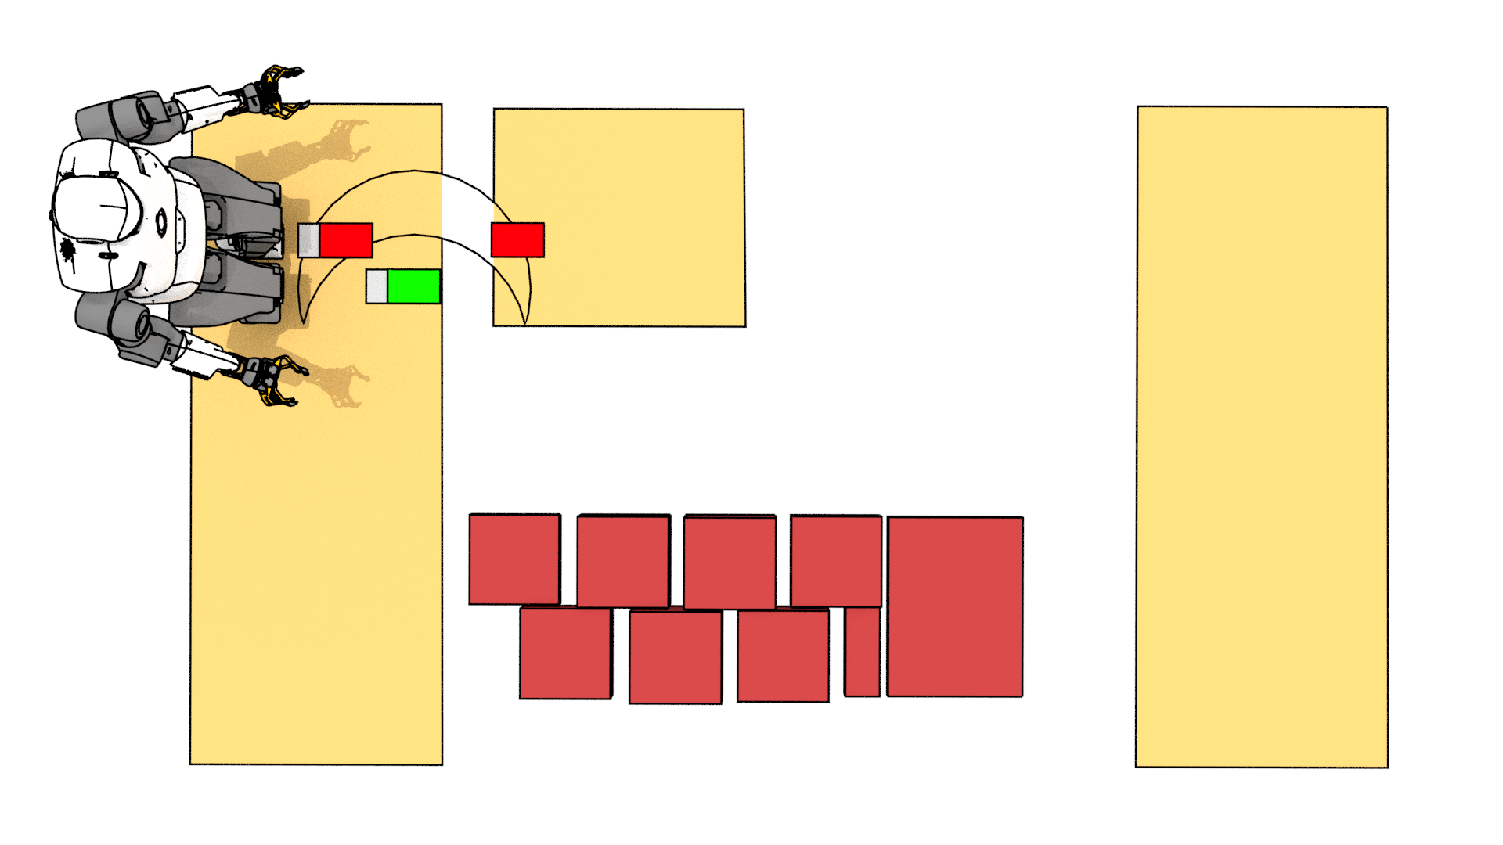
COMBINATORIAL STEP PLANNING
Feasibility :
Geometric constraints
Notes:
It appears safer to backtrack our contact plan and place the first step a little bit forward. This allows for the third step to lie completely on the second platform.

Slide 9
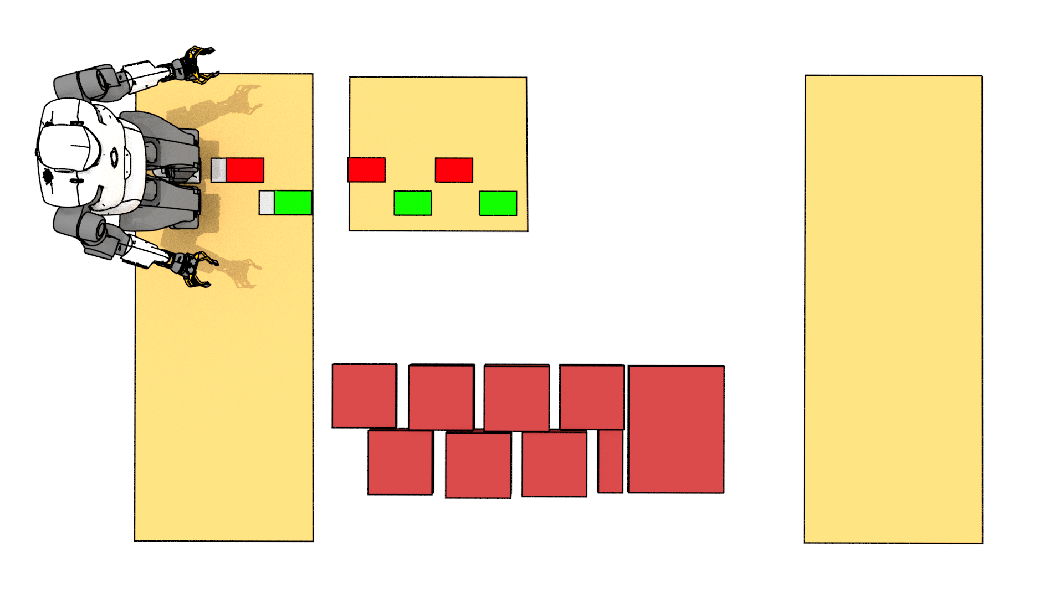
COMBINATORIAL STEP PLANNING
Global path search
Feasibility :
Geometric constraints
Notes:
Unrolling our naïve policy, we end up in a local minima. You probably saw it coming a while ago, but most algorithms will exhibit this myopic behaviour as they only
plan a few steps ahead. We thus need to plan the path to our goal GLOBALLY, with as many steps in advance as possible. This is of course problematic when dealing
with combinatorial problems.

Slide 10
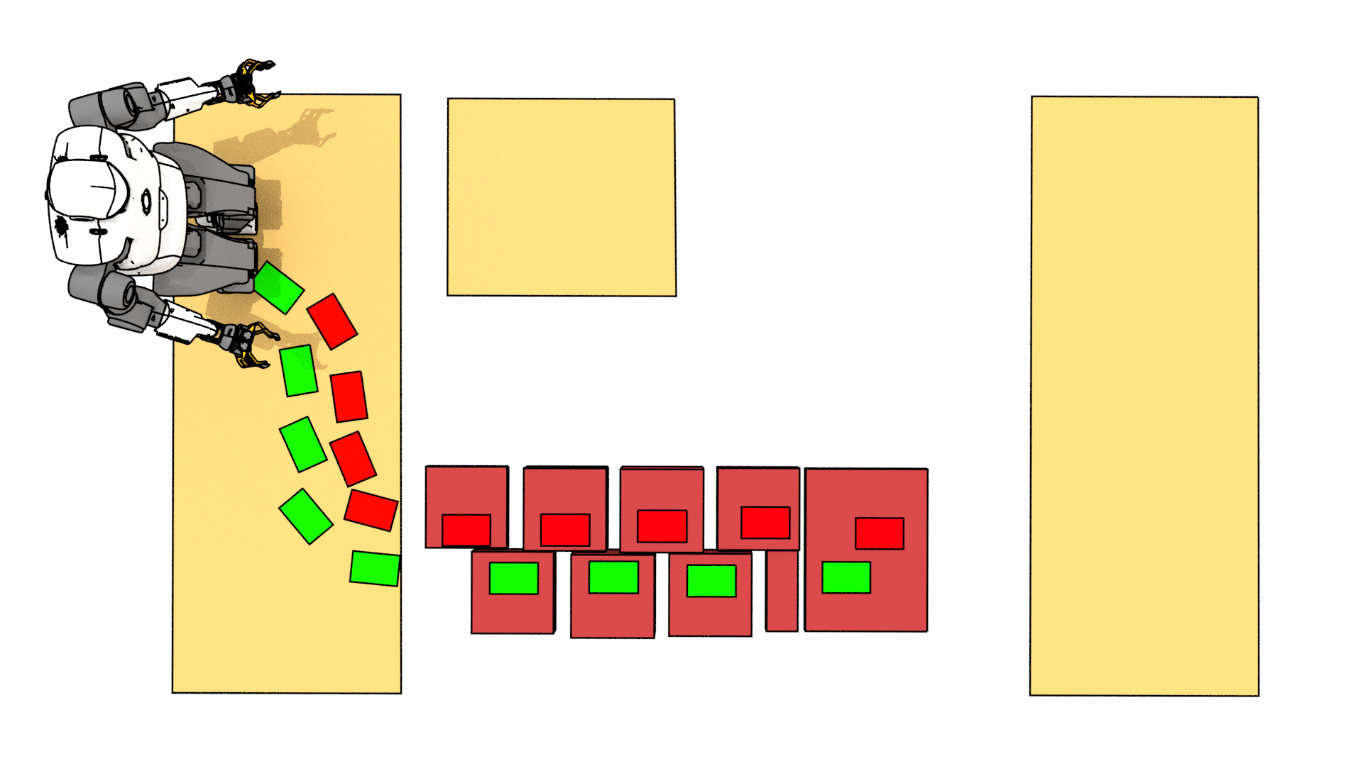
COMBINATORIAL STEP PLANNING
Global path search
Feasibility :
Geometric constraints
Notes:
Backtracking again, after a few trials and error we may end up in this situation. We are at the border of the red stepping stones, however we are not able to cross the final step.
Again, our plan is not feasible. This time it is not because of geometric constraints but because of the dynamics.

Slide 11
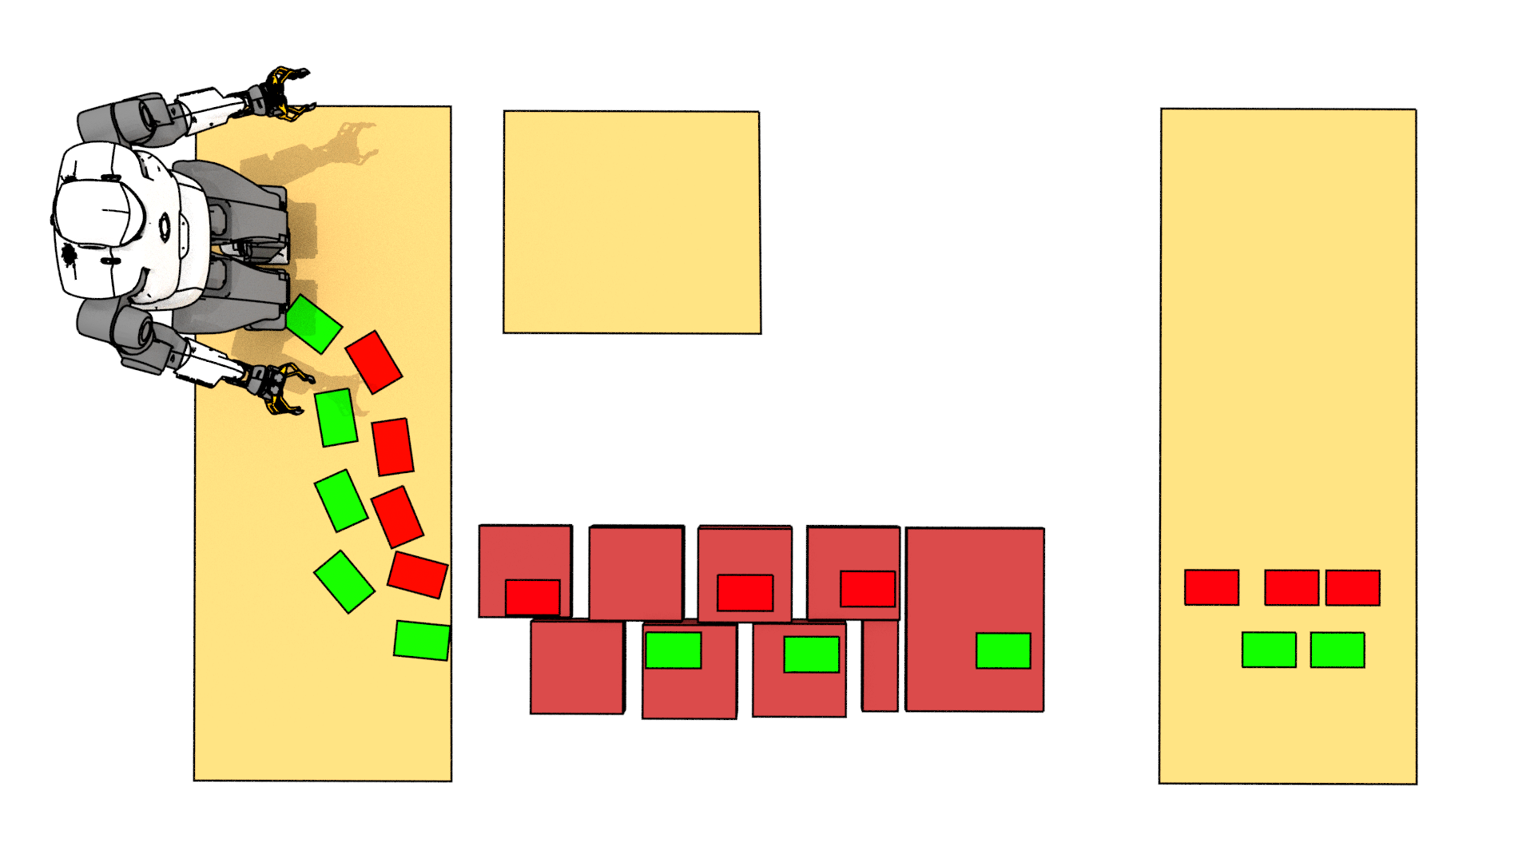
COMBINATORIAL STEP PLANNING
Global path search
Feasibility :
Geometric constraints
Dynamic constraints
Notes:
To cross the gap we need to reach the last stepping stone with enough velocity to jump. Dynamic feasibility must thus be considered as well. The issue is obvious in this dynamic situation, however even when walking
We must of course continuously ensure that the robot can maintain equilibrium while following the footsteps.

Slide 12
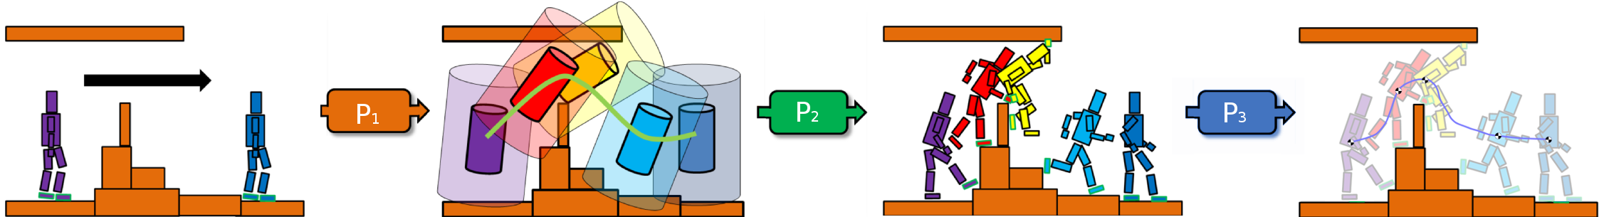
A DIVIDE AND CONQUER APPROACH
[Tonneau et al. 15]
Global path planner
Contact
Planner
Whole body motion
generator
Notes:
With the same idea of breaking down the difficulty of generating motions, a few years ago we proposed to decompose the issue of generating motion from scratch into 3 distinct problems, P1, 2 and 3, solved sequentially. Look at the problem definition on the left. The issue is to compute a motion from the purple posture to the blue one.
First in P1, we propose to compute a rough trajectory for the root of the avatar, a 6D problem where we only consider the position and orientaiton of the root.
Then in P2, we discretize the obtained guide path and generate key postures in contact along it to obtain a contact plan.
Then the last stage P3 consists in generating a continuous and valid motion that interpolates the contact plan and satisfies the various constraints of the problem.

Slide 13
A DIVIDE AND CONQUER APPROACH
[Tonneau et al. 15]
Global path planner
Contact
Planner
Whole body motion
generator
Solving in the feasibility domain of ?
Notes:
For such a decomposition to work, we need to address a feasibility issue. How to guarantee that the planned guide path can be turned into a convincing contact plan,
in turn transformed into a feasible continuous motion ?
For the first problem P1, we have shown that approximated constraints often provide good results, so we focused on necessary conditions for feasibility.

Slide 14
FOCUS ON CONTACT PLANNING
Contact
Planner
Solving in the feasibility domain of ?
Notes:
For such a decomposition to work, we need to address a feasibility issue. How to guarantee that the planned guide path can be turned into a convincing contact plan,
in turn transformed into a feasible continuous motion ?
For the first problem P1, we have shown that approximated constraints often provide good results, so we focused on necessary conditions for feasibility.

Slide 15
WHICH CONTACT SURFACE ?
?
?
?
?
?
?
?
?
?
?
?
?
Notes:
In summary, at each new step we must choose a contact surface such that the motion is feasible and make sure that it allows us to make progress towards our goal.
Let’s formalize the contact selection problem.

Slide 16

WHICH CONTACT SURFACE ?
Convex contact surfaces:
Footsteps positions:
?
?
?
?
?
?
?
?
?
?
?
?
Notes:
We assume a quasi flat environment, with n candidate contact surfaces. We assume the surfaces are convex. Thus a surface Sj can be represented by a set of linear inequalities.
At each new phase i we associate one footstep position p_i.

Slide 17

WHICH CONTACT SURFACE ?
Convex contact surfaces:
Footsteps positions:
Combinatorial:
?
?
?
?
?
?
?
?
?
?
?
?
Notes:
A contact point p_i is constrained to belong to any of the n surfaces.
So for each step, there are n possibilities. For planning m steps, there are n to the power of m possible combinations.
The number of possibilities thus explodes with the number of steps that we want to plan.

Slide 18
COMPLEXITY CAN BE REDUCED WITH A GUIDE
Contact surfaces
Steps:
Combinatorial:
?
?
?
?
?
?
?
?
?
?
?
?

Slide 19

CONTACT PLANNING AS A
FEASIBILITY PROBLEM
// Feasibility
// Initial and goal conditions
Notes:
Our problem can be written in the following general form:
Find m contact positions (that s the variable X), such that the kinematic and dynamic feasibility of the plan is guaranteed, and such that
The initial and final conditions of the problem are met. (In our previous example a goal condition is that the robot lies on the platform on the far right)
The combinatorial constraint is that at each phase I, the contact position pi must lie on either of the contact surface.

Slide 20
CONTACT PLANNING AS A
FEASIBILITY PROBLEM
// Feasibility
// Initial and goal conditions
How to tackle the combinatorics ?
Notes:
This is our starting point. Let’s try to see how we can try to handle the combinatorial efficiently.
Handling the OR constraint usually involves solving a mixed integer linear program, which can lead to a combinatorial explosion.
Our objective is thus to get rid of the OR constraint and relax this problem as a convex linear programm. For this, we will assume that the feasibility, initial and goal
Constraints are convex, as detailed in the paper.

Slide 21
AN EQUIVALENT CARDINALITY MINIMIZATION PROBLEM
Notes:
If a point pi lies on SJ, then this inequality is necessarily satisfied.
In our example there are no overlap between the contact surfaces so only one such inequality can be satisfied at each phase.
But what if we wanted to satisfy them all simultaneously ?

Slide 22
AN EQUIVALENT CARDINALITY MINIMIZATION PROBLEM
Slack variables
0.1
1
0
2
1
1
1
1
1
1
1.5
1
Notes:
We can introduce positive slack variables c i j, one for each contact surfaces at each phase. For an arbitrarily large value of c i j the constraints will always be satisfied.
On the other end if c i j is equal to 0 then necessarily pi belongs to the surface sj

Slide 23

AN EQUIVALENT CARDINALITY MINIMIZATION PROBLEM
Slack variables
0.1
1
0
2
1
1
1
1
1
1
1.5
1
Notes:
We can introduce positive slack variables c i j, one for each contact surfaces at each phase. For an arbitrarily large value of c i j the constraints will always be satisfied.
On the other end if c i j is equal to 0 then necessarily pi belongs to the surface sj

Slide 24

AN EQUIVALENT CARDINALITY MINIMIZATION PROBLEM
Slack variables
0.1
1
0
2
1
1
1
1
1
1
1.5
1
Notes:
We can use the ci vector, which contains all the c i j, to draw a necessary condition for the point pi to lie on a surface. If the number of non zeros in ci is less than the total number of surfaces, pi is necessarily on a contact surface. This number is called the cardinality
of the vector. As our surfaces are not intersecting, we know that the minimum value is n-1.

Slide 25

AN EQUIVALENT CARDINALITY MINIMIZATION PROBLEM
0.1
1
0
2
1
1
1
1
1
1
1.5
1
Notes:
This shows that finding a point pi on a surface is strictly equivalent to an optimization problem where we try to minimize the cardinality of the slack vector ci.
At the minimum one of the cij is equal to 0, thus pi belongs to a surface.

Slide 26

AN EQUIVALENT CARDINALITY MINIMIZATION PROBLEM
Notes:
We can thus reformulate our original problem and remove completely the or constraint.
We traded the feasibility problem for a strictly equivalent minimization problem.
Still, minimizing the cardinality of a vector is in fact also a mixed integer optimization.
So it seems that we have not progressed that much!

Slide 27
WE ARE HAPPY BECAUSE THIS IS A (CONVEX?) MIXED INTEGER PROBLEM
[Deits et al. 15]
Branch and bound algo.
Off-the shelf solvers:
  Gurobi, etc…
Possibly expensive
  => Can we do better ?

Slide 28
CONVEX RELAXATION WITH A SPARSITY INDUCING NORM
[Bach et al. 11]
Notes:
Fortunately, it is well known that the cardinality minimization problem can be well approximated by a l1 norm minimization problem.
The l1 norm minimization induces sparsity which means that we can hope that some entries of the ci vectors will be 0 at the end of the optimisation.
This allows us to reformulate a combinatorial mixed integer problem into a standard linear program.
Unfortunately we have no guarantees of convergence. Please refer to the paper for a discussion on the handling of those cases.

Slide 29
RELAXATION GIVES MUCH FASTER RESULTS… WHEN IT CONVERGES
L1 up to 100x faster than Branch and Bound…
  5 steps 0.7 ms
What to do when relaxed problem does not converge to a sparse solution ?
Notes:
The main advantage of the approximation is computational efficiency. Our method 100 times faster than the mixed integer formulation in the most favorable cases when considering
an additional objective function
However the drawback is that the relaxation can converge to unfeasible solutions, and handling those cases can reduce the computational advantage.
Further research is needed to deeply understand the cases where sl1m is advantageous over MIP.

Slide 30
FEASIBILITY VS OPTIMALITY
SL1M essentially solves a feasibility problem
Optimality of the motion not guaranteed
Does it really matter ?
Notes:
Another important point the question of feasibility versus optimality.
Rather than simply finding a contact plan that solves our problem, we may be interested in choosing a plan that will minimize a given cost functional.
In the sl1m formulation, this cost will be added to the l1 norm minimization cost, meaning that the optimum of the relaxed problem is unlikely to be the optimum of the original problem.
Our early results indicate however that solving he feasibility problem before computing an optimal motion once the contact surfaces have been selected gives good empirical results.
Here again further research will determine whether the theoretical problem is also a practical one.
Conversely, Investigating the performances of the mixed integer program formulation when only solving feasibility and not optimizing a cost is another interesting direction of research.

Slide 31
THAT’S ALL FOR NOW !
https://stevetonneau.fr for paper, video, source code
Notes:
That s about all I have to say in 10 minutes. Please consult my website stevetonneau.fr for the paper, video and source code. I will be very happy to take questions during ICRA or at any other time by email.

Slide 32
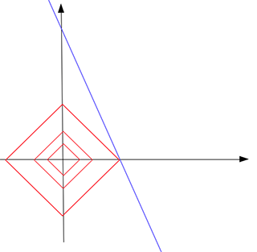
L1-NORM MINIMIZATION INDUCES SPARSITY

Slide 33
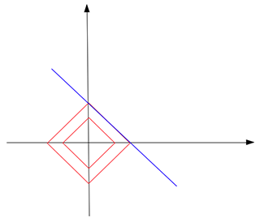
… BUT SOMETIMES NOT

Slide 34
L1-NORM INDUCES SPARSITY

Slide 35
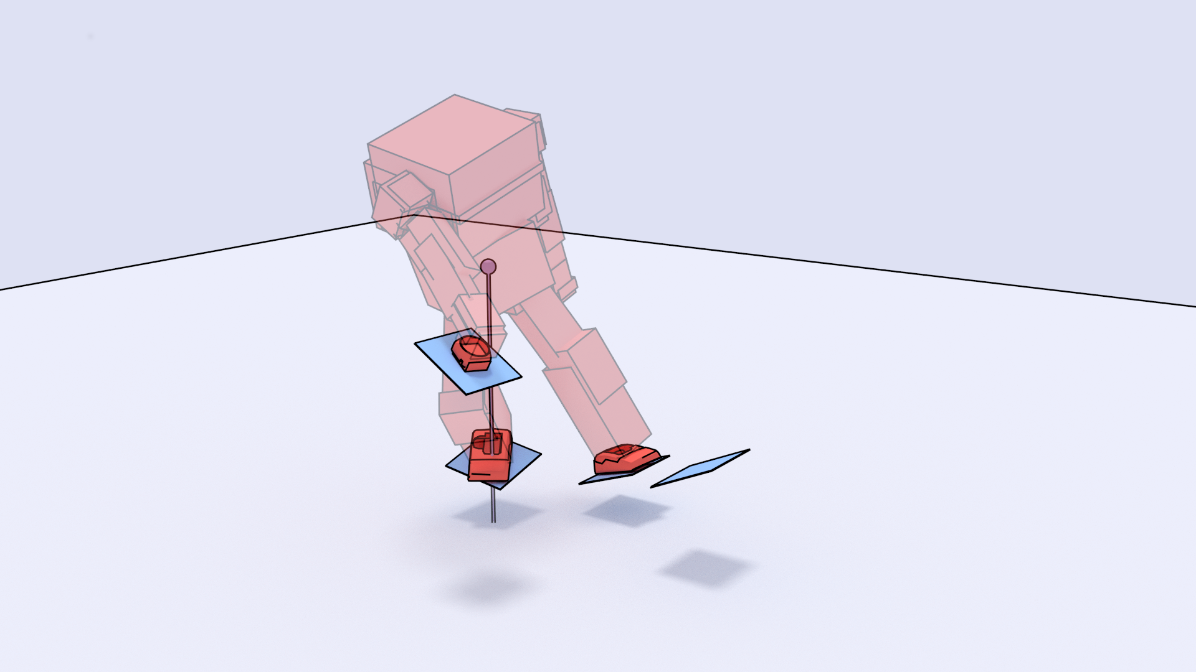
APPROXIMATING AT COM LEVEL

Slide 36
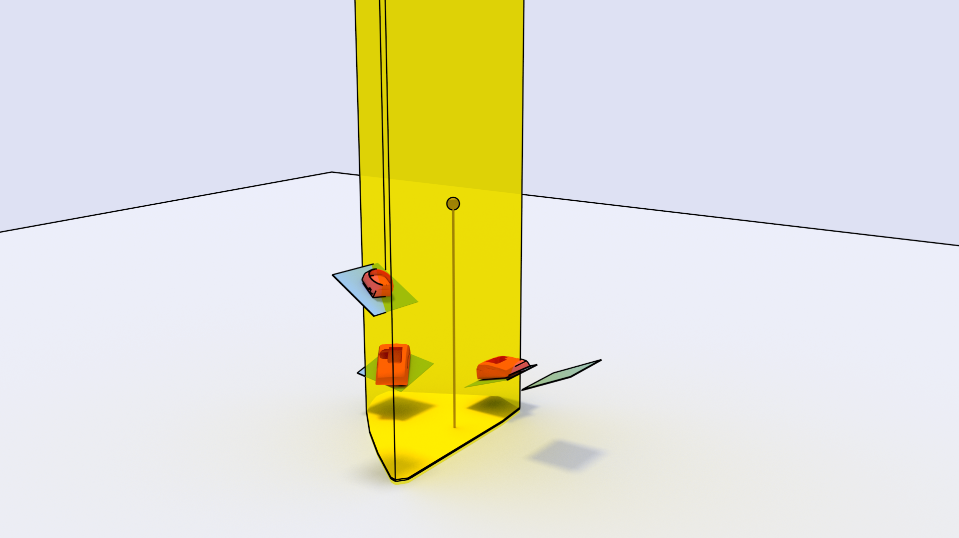

DYNAMIC FEASIBILITY [Caron et al. 15]
(static is 3D, dynamic is 6D)

Slide 37

KINEMATIC FEASIBILITY:
COM / other effectors in effector frame

Slide 38
KINEMATIC FEASIBILITY:
COM / other effectors in effector frame

Slide 39
SIMULTANEOUS HANDLING OF SEVERAL CONSTRAINTS

Slide 40
CONTACT PLANNING AS A
FEASIBILITY PROBLEM

Slide 41
WHICH CONTACT SURFACE ?
?

Slide 42


Slide 43
Thanks !

